Slide 1
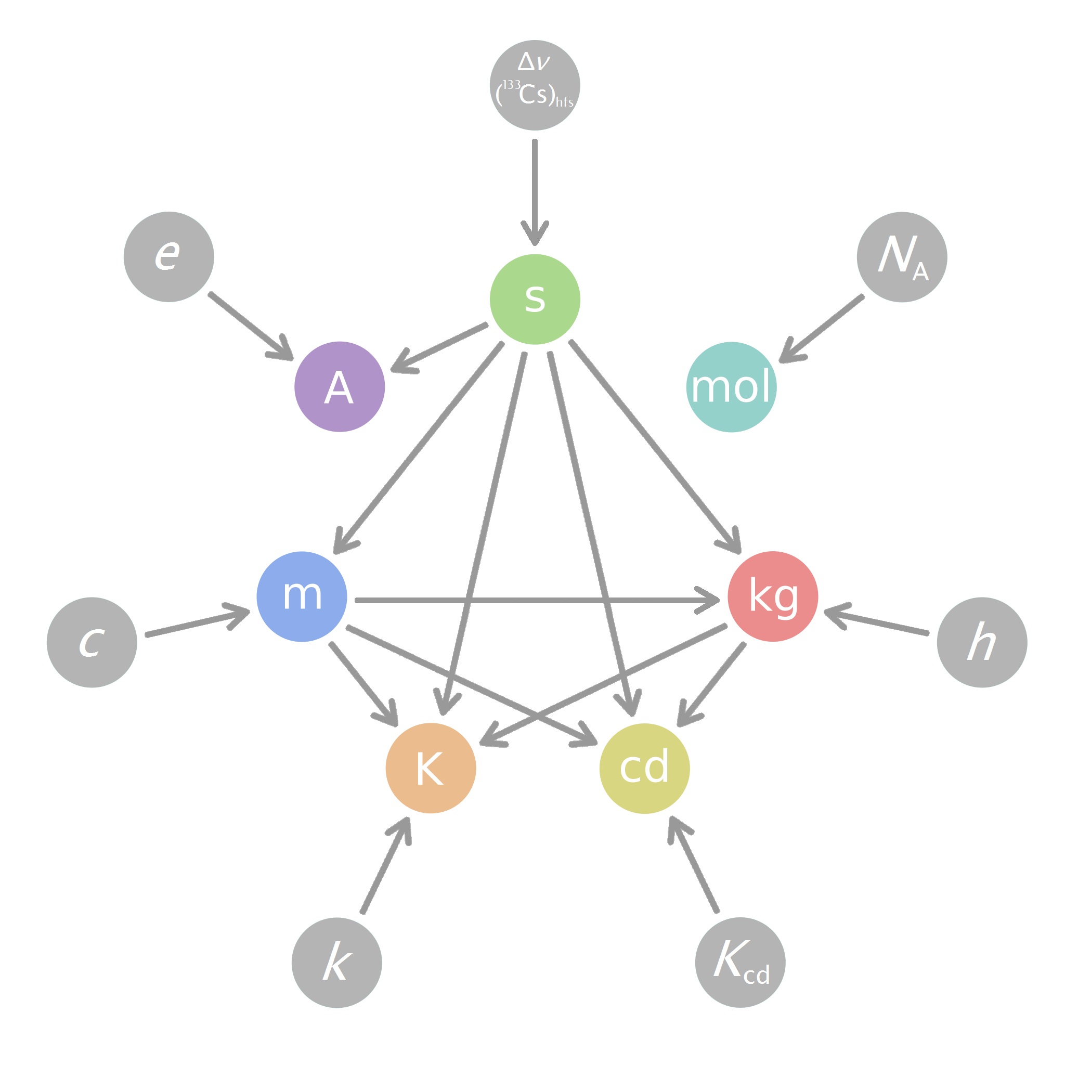
The Unidata UDUNITS-2 Package for the Handling of Units of Physical Quantities
Steve Emmerson
2012 Unidata netCDF Workshop

Slide 2
What About the Package?
Programmatically converts between string specifications of units of physical quantities and internal binary representations
Operates on the binary unit representation
  Unary Operations: raise to a power, logarithm, etc.
  Binary Operations: multiply, divide, compare, etc.
Converts numeric values between binary unit representations
Has a library and a utility (program)
Has a user-editable database
Written in C

Slide 3
Converting from String to Binary
include <udunits2.h>
...
ut_system* system = ut_read_xml(NULL);
ut_unit* watt = ut_parse(system, “joule/second”, UT_ASCII);
ut_unit* fahrenheit = ut_parse(system, “K/1.8 @ 459.67”, UT_ASCII);
ut_unit* wattPerOhm = ut_parse(system, “(kg·m²)/(s³·Ω)”, UT_LATIN1);
The supported characters encodings are US ASCII, ISO 8859-1 (Latin-1), and UTF-8 (Unicode)

Slide 4
Unary Operations
include <udunits2.h>
…
ut_unit* yard = ut_scale(3, foot);
ut_unit* celsius = ut_offset(kelvin, 273.15);
ut_unit* meter2 = ut_raise(meter, 2);
ut_unit* meter = ut_root(meter2, 2);
ut_unit* bel1mW = ut_log(10, milliwatt);
…
ut_free(yard);

Slide 5
Binary Operations
include <udunits2.h>
…
ut_unit* newtonMeter = ut_multiply(newton, meter);
ut_unit* meterPerSecond = ut_divide(meter, second);
…
if (ut_compare(unit1, unit2) == 0) {
/* Same units */
…
}

Slide 6
Converting Values
include <udunits2.h>
…
if (ut_are_convertible(foot, meter)) {
cv_converter* ft2m = ut_get_converter(foot, meter);
float meter = cv_convert_float(ft2m, 3);
float* feet = …; /* input array of n floats */
float* meters = …; /* output array of n floats */
cv_convert_floats(ft2m, feet, n, meters); // _doubles(…)
cv_free(ft2m);
}

Slide 7
UDUNITS-2 Utility
$ udunits2 -A
udunits2: using default XML database
You have: watt
You want:
m2.kg.s-3
You have: furlongs/fortnight
You want: cm/minute
1 furlongs/fortnight = 0.997859 cm/minute
x/(cm/minute) = 0.997859 (x/(furlongs/fortnight))
You have: ^D
$

Slide 8
XML Database
<?xml version=”1.0” encoding=”US-ASCII”?>
<unit-system>
<import>udunits2-prefixes.xml</import>
<import>udunits2-base.xml</import>
<import>udunits2-derived.xml</import>
<import>udunits2-accepted.xml</import>
<import>udunits2-common.xml</import>
</unit-system>

Slide 9
XML Database of Common Units
<?xml version=”1.0” encoding=”US-ASCII”?>
<unit-system>
<unit>
<def>4.5359237e-1 kg</def>
<aliases>
<name><singular>avoirdupois_pound</singular></name>
<name><singular>pound</singular></name>
<symbol>lb</symbol>
</aliases>
</unit>
…
</unit-system>

Slide 10
Challenges
No Fortran support in the package yet, but Michel Valin has a Fortran-2003 interface module on GitHub:
  https://github.com/mfvalin/wrapper-code
Timestamp “units”
  Example: “seconds since 2012-10-10 17:17:00 -6:00”
  Gregorian calendar only (ergo, no 360-day calendars)
  No leap seconds
  Appropriate for simple situations only

Slide 11
Resources
Web Site Homepage
  http://www.unidata.ucar.edu/software/udunits
FOSS Repository
  https://github.com/Unidata/UDUNITS-2
Email Support
  support-udunits@unidata.ucar.edu

