Slide 1
NetCDF and
Related International Standards
Ben Domenico
October 2012

Slide 2
Outline
Brief historical context
Unidata/partners have established a solid foundation: Standard data access interfaces enable other Earth System Science communities to access Unidata datasets
Recent progress: data model, interface, encoding standards
Current focus, web services brokering layer:
  new architecture with broker between clients and web servers
  CF-netCDF data model makes brokering possible
Future directions: data analysis and display via publications, educational modules and other documents

Slide 3
Navigating Earth System Science Data vs. service to Unidata core community?
Evolution of Unidata data systems
Guidance from proposal review panel regarding outreach vs. service to core community
Focus near the boundary of our core community
Make our data available more broadly and gain access to other data source in useful forms
Implement/support up to standard interface
  Unidata does NOT support other communities’ tools
  Unidata does NOT provide expertise in other domains
  We get others to do most of the hard work

Slide 4
Unidata Data Systems Evolution
IDD/LDM: Publish/subscribe (push) system for real-time data, i.e.,
move the data to the user sites and provide tools to analyze and display the data on student and faculty workstations
THREDDS Data Server: Client/server (pull) for retrospective and cross-disciplinary, i.e.,
data, analysis and display client tools access data from servers (local or remote)
What next?

Slide 5
Typical Data Handling at a Unidata Site
Unidata user
running local
analysis and display tools
Unidata user
running local
analysis and display tools
Forecast Model Output
Weather station observations
Application specific protocols
Decoders
Satellite imagery
Decoders
Local data decoded into application specific formats
IDD
Radar data
Decoders
Decoders
Decoders
Lightning, aircraft, GPSmet, etc.

Slide 6

Thematic Real-time Environmental Distributed Data Servers (THREDDS)
Integrate environmental data and tools into the world wide web
Combine IDD “push” with several forms of pull and DL discovery
About 25 data providers are THREDDS partners
Connecting people, documents, and data
User applications:
e.g.,
McIDAS
, IDV,
LAS, IDL, MatLab...
Satellite
Satellite
Hydrology
Geophysical
Images, e.g.
Images, e.g.
Data, e.g.
Data, e.g.

Slide 7
Unidata 2013 Review Panel Question
Question: Is the UPC prepared to provide the same quality of support to the newly engaged communities as it provides to its current constituents?
Response: While the support for all users will remain at a very high level, that does not mean it will be exactly the same.
  Data access with supported analysis and display tools for our community
  Data access via standard interfaces to enable other communities to use our data with their own tools (arcGIS, IDL, Matlab, etc.)

Slide 8
Excerpts from Review Panel Report
The UPC could play a significant leadership role within committees and consortiums like OGC seeking to address the need to develop standards and technologies for data discovery
Unidata leadership and advocacy in this area could facilitate expanded utilization of Unidata information resources for other research areas like climate and provide Unidata users with easier access to other data sources like NASA satellite information

Slide 9
Collaborating Communities
Oceanography
Conventions and
Standards
Cross-cutting
Core Constituency:
U. S. Meteorology
Research and Education
Community
Coastal Oceans
Societal
Impacts
Hydrology
Hazards/
Extreme Events
Climate

Slide 10
Standard Interface Web Services for
Interoperability with GIS Community
GIS clients:
e.g., Google Earth,
arcGIS, IDL, Matlab, etc.
Unidata clients:
IDV, McIDAS,
GEMPAK, AWIPS
Proprietary GIS
protocols
Standard protocols:
WMS, WFS, WCS, CSW
Community protocols:
THREDDS, OPeNDAP,
ADDE. FTP…
GIS Servers
Community Servers
GIS Server
THREDDS Server
GIS Server
THREDDS Server
Hydrologic, demographic, infrastructure, societal impacts, … datasets
Satellite, radar,
forecast model output, …
datasets

Slide 11
Disparate Data Models:
Different Ways of Thinking about Data
To the GIS (solid earth and societal impacts) community, the world is:
  A collection of static features (e.g., roads, lakes, plots of land) with geographic footprints on the Earth (surface).
  The features are discrete objects with attributes which can be stored and manipulated conveniently in a relational database.
To the fluids (atmosphere and oceans) communities, the world is:
  A set of parameters (e.g., pressure, temperature, wind speed) which vary as continuous functions in 3-dimensional space and time.
  The behavior of the parameters in space and time is governed by a set of equations.
  Data are simply discrete points in the mathematical function space.
Each community is making progress in understanding and adapting to needs and strengths of the other. Progress areas will be highlighted
Notes:
In the realm of geolocated datasets, data stored in Geographic Information Systems (GIS) are highly structured and most often stored in an underlying relational database. While this may be a gross simplification, GIS datasets typically consist of “features” on the surface of the Earth that can be represented by points, lines and polygons. An example is a county plat which can show natural features such as streams and rivers, infrastructure like roads and bridges and buildings, and plots of land such as towns, lots, and so forth. The attributes of these features lend themselves to storage in the tables of a relational database. There can be a table for the roads, another for the towns, yet another for the rivers, etc. Each specific feature is a record in a table which provides a very useful way of keeping track of the characteristics of each instance of each feature.
Visualization is conceptualized in terms of a set of “layers.” In the physical world, transparent mylar sheets are often used to overlay various sets of features on a given base map. The same idea is used for manipulating the visualization of the classes of features in GIS visualization systems
Generally speaking, AS datasets are characterised by the following observational nature:
• high dimensionality (e.g. four or more dimensions);
• multivalued parameters, characterized by a tensor rank (e.g. a brightness temperature parameter can be characterized by several values, one for each acquisition channel; its rank is equal to the number of acquisition channels);
The VisAD data model assumes that data objects are approximations to mathematical functions.

Slide 12

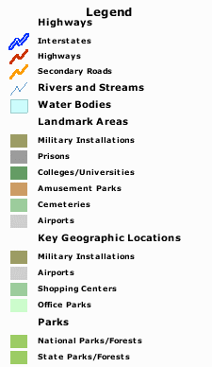
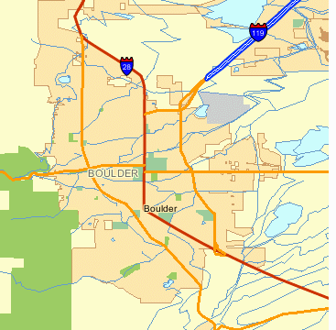
Traditional GIS view
Features as points, lines, polygons
Attributes in DBMS tables
Notes:
In the realm of geolocated datasets, data stored in Geographic Information Systems (GIS) are highly structured and most often stored in an underlying relational database. While this may be a gross simplification, GIS datasets typically consist of “features” on the surface of the Earth that can be represented by points, lines and polygons. An example is a county plat which can show natural features such as streams and rivers, infrastructure like roads and bridges and buildings, and plots of land such as towns, lots, and so forth. The attributes of these features lend themselves to storage in the tables of a relational database. There can be a table for the roads, another for the towns, yet another for the rivers, etc. Each specific feature is a record in a table which provides a very useful way of keeping track of the characteristics of each instance of each feature.
Visualization is conceptualized in terms of a set of “layers.” In the physical world, transparent mylar sheets are often used to overlay various sets of features on a given base map. The same idea is used for manipulating the visualization of the classes of features in GIS visualization systems

Slide 13
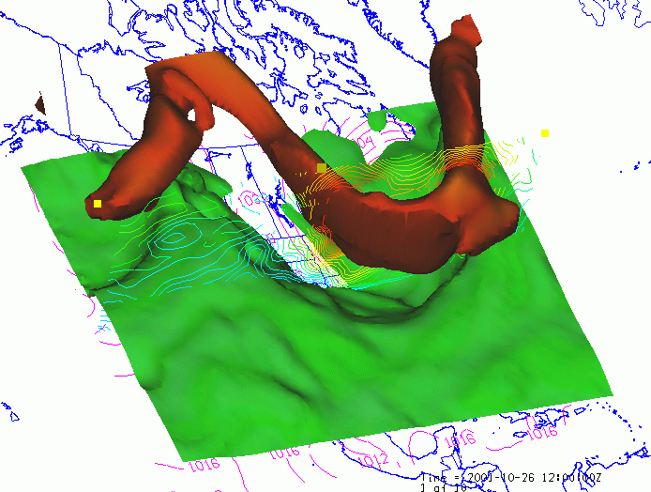
Typical NetCDF Visualization

Slide 14
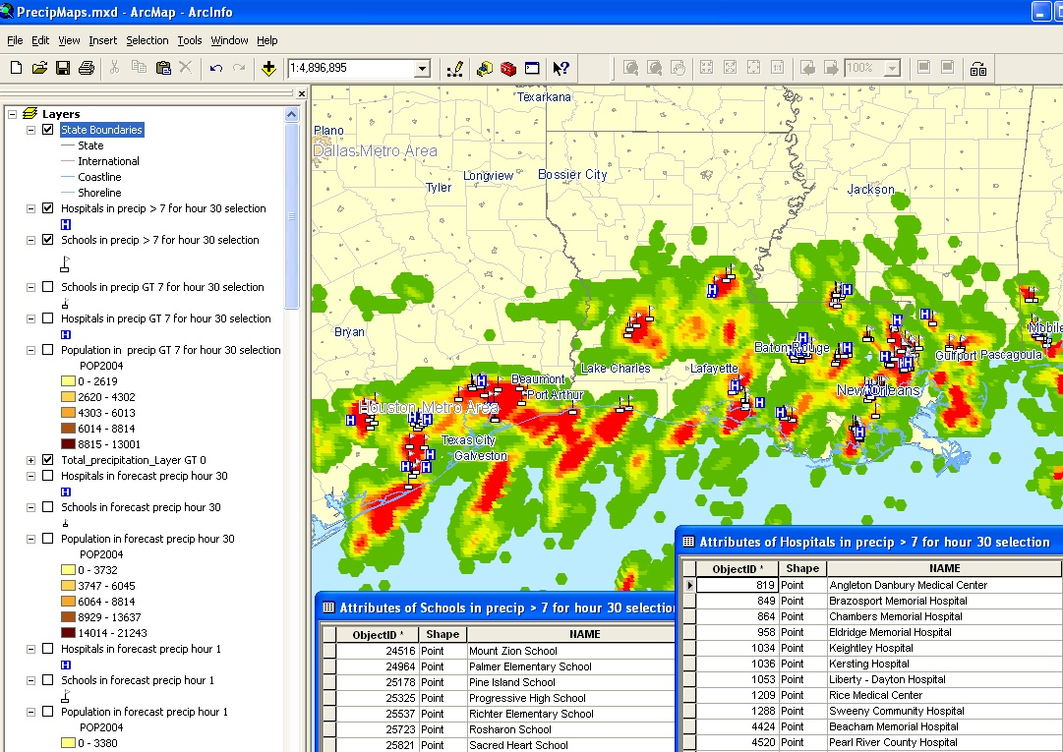
GIS Tools Applied to
Atmospheric Science Data

Slide 15
A Few of the Collaborating Organizations
NOAA (e.g., PMEL, PFEL, NCDC, NGDC, IOOS?)
NASA
USGS
OGC (Open Geospatial Consortium)
CF (Climate and Forecast) Community
CUAHSI (Hydrology)
NCAR (GIS Program, CISL, …)
NEON (National Ecological Observatory Network) Data Services
International (Italian National Research Council, British Atmospheric Data Center, University of Reading E-science Center, Meteo France, Australian Bureau of Meteorology, …)
Industry (ESRI, ITTvis, Applied Science Associates, …)

Slide 16
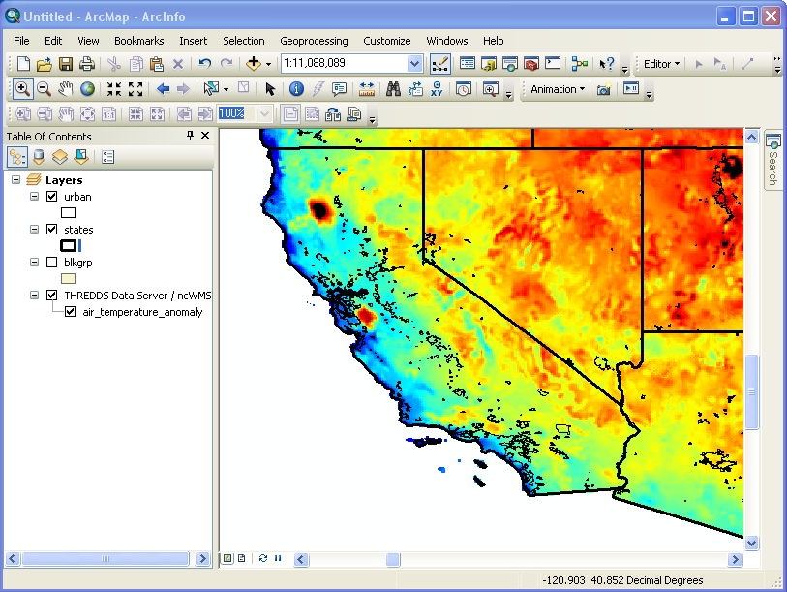
Collaboration Illustration: ArcMAP Display of NCAR Data from THREDDS Web Map Server
NCAR model
air temperature anomaly display
Data from NCAR climate model
TDS software from Unidata
WMS software from University of Reading
Server run by NCAR GIS program
GIS map and analysis software from ESRI

Slide 17
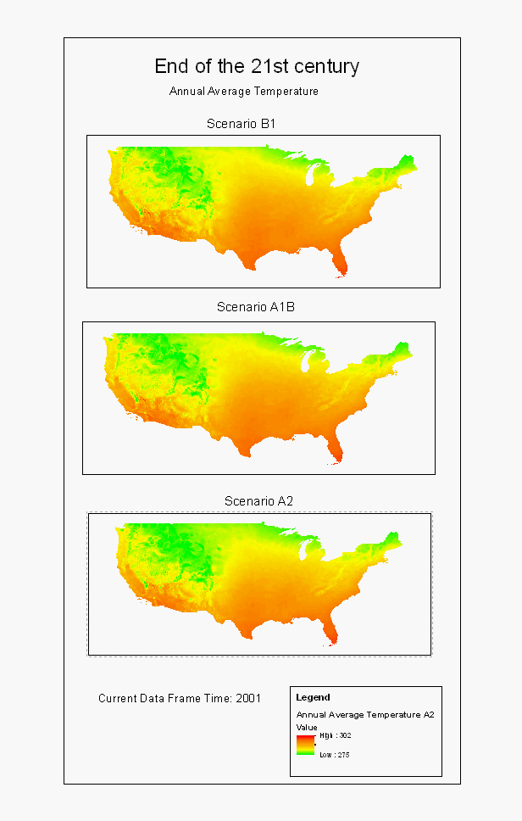
“Collateral Successes”
Annual average temperature directly read from netCDF file into ESRI arcMAP
Images can be accessed via WMS
Data can be accessed via WCS
Temporal animation now much more convenient in new versions of ESRI tools
Similar to earlier successes with IDL, Matlab, Ferret, GRaDs and many other analysis and display tools.

Slide 18
Recent Progress
netCDF (classic and enhanced) adopted as (first) OGC binary encoding standard
netCDF read/write incorporated direction into ESRI arcGIS
Draft OGC spec for CF extension to netCDF core with Italian National Research Council (CNR)
Draft OGC spec for CF-netCDF extension to WCS with CNR
Working on extension spec for netCDF enhanced (netCDF4) data model
“Crossing the Digital Divide” data discovery experiment with CUAHSI and CNR
User community incorporating GI-cat catalog metadata harvesting for THREDDS Data Servers (Rich Signell created a configuration video.)
GEOSS arctic climate and weather demonstration with USGS, NCAR GIS, GMU, Michigan Tech
Harmonization of CSML and CDM scientific feature types with BADC and CF community
NCPP (NOAA Climate Projection Pilot) with NOAA, USGS, NCAR GIS, Michigan Tech)
WMO community joins OGC and MetOceans working group formed
OPeNDAP has joined OGC
Discussed plans with CF community to coordinate data model developments
HDF5 is part of OGC Web Services phase 8 testbed
Hosting OGC Technical Committee and GEOSS Climate Workshop in Sept.
Participating in University Consortium for GIS and CUAHSI GIS in June
Participating in International Coastal Oceans Network 5 Workshop in August
Invited to international workshop on Networking of Air Quality Data Systems

Slide 19
Status of CF-netCDF OGC Standards Development
Stefano Nativi, Italian National Research Council, Institute of Methodologies for Environmental Analysis, Prato, Italy
Ben Domenico, Unidata Program Center, University Corporation for Atmospheric Research, Boulder, USA
CF-netCDF
application
profiles
Forecast Model
Output
Weather Station Obs
Satellite
Imagery
Coastal Ocean Model
…
{
netCDF extensions
Irregular Grid
Java
Radial
Swath
HDF 5
ncML-GML
Fortran
Sampling Types
Point/Station
( Discrete Sampling)
64-bit offset
C
Grid
ncML
...
Classic
CDL
netCDF Enhanced
CF
...
…
...
...
...
Binary
encodings
XML
encodings
Text
encodings
data model
conventions
APIs
CF-netCDF core
netCDF Classic Dataset
Legend:
abstract extension
categories
OGC CF-netCDF 1.0
as of August 2012
Extension being voted on by OGC Tech. Committee
Possible future
extensions

Slide 20
Recent Focus in OGC
Enhanced data model (netCDF4) extension to netCDF core spec (formally adopted last month)
CF extension to OGC netCDF core spec
(being voted on at this moment)
CF-netCDF extension to WCS core spec
(in draft form)
CSML and CDM/CF Feature Types
Hosted September 2011 OGC Technical Committee Meetings

Slide 21
So What?
Enables cross-disciplinary use of data without undo drain on support for core constituency
Fosters awareness and adoption of Unidata infrastructure
Makes more data systems compatible with Unidata tools and services
Provides access to more data from different, organizations, disciplines, and regions discoverable – with documentation and in usable forms
Satisfies legal requirements for some organizations, e.g., in EU, required by law to use standard-compliant software
Encourages valuable international collaborations on development of tools and provision of services
Makes new work paradigms and system architectures possible

Slide 22
Advantages and Limitations of
Web Client / Server Architecture
Agreeing on protocols, enables communication between programs:
  developed by different groups,
  in different languages
  running on different machines on different networks
In practice:
  Clients and servers support limited number of protocols and encodings.
  Too often, clients only communicate well with servers developed by same group.

Slide 23
Practical Limitations of Web
Client / Service Architecture
WCS 1.0
Client
OPeNDAP
Client
CS/W ebRim
Client
WCS 2.0
Client
CS/W - ISO
Client
OpenSearch
Client
WCS 1.0
Web Service
OPeNDAP
Web Service
CS/W ebRim
Web Service
WCS 2.0
Web Service
CS/W - ISO
Web Service
OpenSearch
Web Service

Slide 24
Three-tiered Architecture with Brokering Layer
WCS 1.0
Client
OPeNDAP
Client
CS/W ebRim
Client
WCS 2.0
Client
CS/W - ISO
Client
OpenSearch
Client
Brokering Service as a Separate Layer
WCS 1.0 Service
WCS 2.0 Service
OPeNDAP Service
CS/W ISO Service
CS/W ebRIM Service
OpenSearch Service
Common Data Model for Data Access Protocols and Formats
Common Metadata Model for Discovery Protocols and Semantics
WCS 1.0 Accessor
WCS 2.0 Accessor
OPeNDAP Accessor
TDS Metadata Acc.
CS/W Accessor
OpenSearch Acc.
WCS 1.0
Web Service
OPeNDAP
Web Service
THREDDS
Data Server
(no formal standard metadata interface)
CS/W ebRim
Web Service
WCS 2.0
Web Service
CS/W - ISO
Web Service
OpenSearch
Web Service

Slide 25
All this Lead to a New Possibility:
Data Interactive Publications
Publications are the valued “exchange medium” of the academic community
Data citation (for transparency, reproducibility, etc.) is an emerging issue for scientific publications
Data access and analysis are the basis of nearly all these publications
Bridges the gap between publications and data analysis
For “big data,” it’s important to have processing take place near the data store.
Approach fits nicely into era of server side (cloud?) computing and mobile client devices?

Slide 26

Data Interactive Publications
Client / Web Server Interoperability
Mobile platform
Desktop with browser
E-book reader
Publication-based
Analysis and Display
GIS desktop clients:
arcGIS, IDL, MatLab
HydroDesktop etc.
Unidata desktop clients:
IDV, McIDAS,
GEMPAK, AWIPS
Brokering Layer
Processing Services
WPS
GIS community protocols
Community protocols:
THREDDS, OPeNDAP, ADDE, FTP, …
Standard Protocols: netCDF encoding via WMS, WFS, WCS, CSW
GIS Servers
Community Servers
GIS Server
THREDDS Server
GIS Server
THREDDS Server
Hydrologic, demographic, infrastructure, societal impacts, … datasets
Satellite, radar,
forecast model output, …
datasets

Slide 27
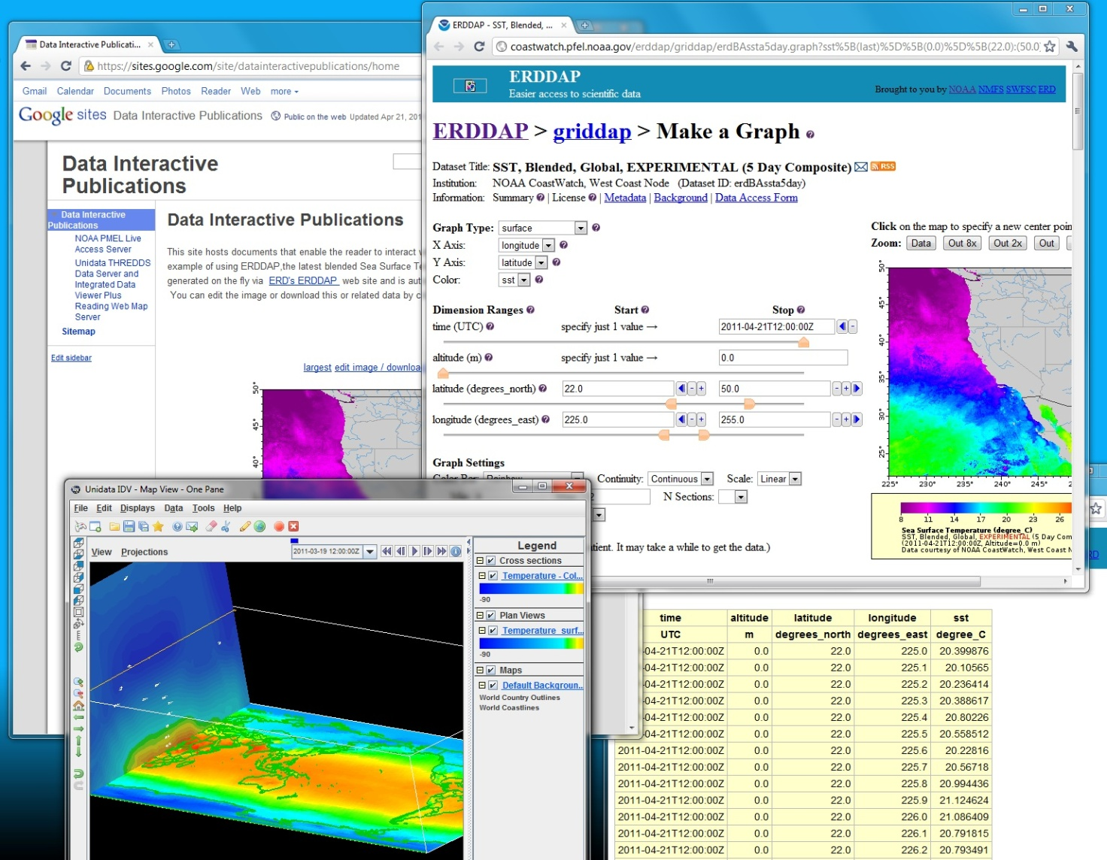
Via Standard Interfaces, Publications Enable Access to Distributed Processing, Tools, Data
Straightforward HTML documents can be created on public wiki or local web server.
Via embedded links, reader accesses data and analysis and display tools.
Tools can be:
thin web clients,
rich desktop applications.
From within the document, reader can interact with data via:
tools,
“live” tables
downloads.

Slide 28
Advantages
Convenient authoring of online publications that enable the reader to access and analyze the data cited in the publication
Cross-disciplinary: enabling readers of scientific publications and educational modules to work directly with data from other disciplines
Professional incentive: makes “documentation” of data a rewarded part of an academic’s job
Transparency: fosters openness by providing broader and easier access to processing and data as well as documents and data products
Search: data interactive publications can be found via Google, Bing, etc. which in turn:
  leads the searcher to the datasets and analysis tools the publication points to
  makes it possible to do Google-type rankings based on pointers into and out of the documents and datasets
Server flexibility: services can be on local workstation/cluster, on central server, in the cloud, or in Wyoming
Efficiency: processing can be performed near “big data” stores
Collaboration: could foster more productive collaborations
Internal Cooperation: would involve both engineering and non-engineering staff within Unidata
Client flexibility: data analysis can be driven from mobile devices as well as desktop

Slide 29
Challenges
New way of thinking for developers and users
Persistence of all components: datasets, processing services, and interfaces
Computing resources: distribution and limitations
Security: authentication and authorization
Primitive web processing services at present
Interfaces are new and generally untried in an environment where people are relying on them
Additional UPC effort: “skunk works?” with collaborators, new or re-programmed staff
Need to engage publications industry

Slide 30
Implications of Recent Developments
Earlier barriers are being overcome:
Browser-based access to interactivity is becoming more common (Live Access Server, TDS/WMS/GODIVA, ERDDAP, FerretTDS…)
Server-side (cloud?) processing is a viable platform for interactivity
RAMADDA/TDS provides mechanism for persistent storage of datasets by user community
Clients with modest processing/storage ability come into play (tablets, smart phones)
Documents, data, storage, data access, processing capabilities, user devices can all be distributed
Processing can be co-located with large datasets.

Slide 31
Issues for Unidata Community
Where does the processing belong?
  In a desktop application (IDV, McIDAS, AWIPS)?
  In an app on mobile devices?
  As a web brokering service in a departmental server?
  As a web brokering service at the UPC?
  In the cloud?
  In Wyoming?
How much emphasis on Earth System Science as opposed to Mesoscale Meteorology?
How many different approaches can be supported?

Slide 32
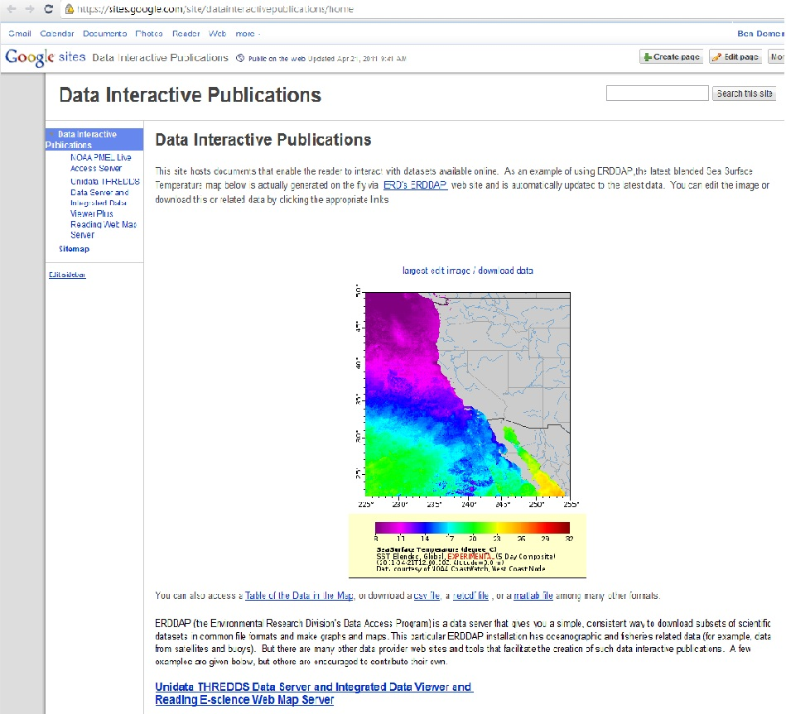
Publication on Google Sites Wiki
Online document created with simple wiki tools
Embedded images generated “on the fly” from another web site
Embedded links enable reader to:
  access related datasets
  perform one’s own analysis and display

Slide 33
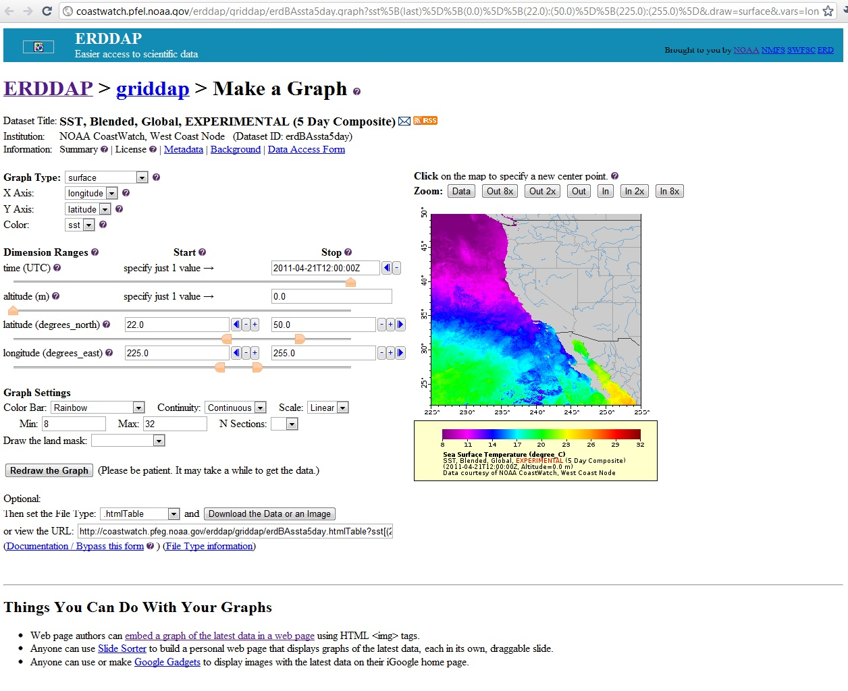
Embedded Links to Online
Data and Analysis Tools

Slide 34
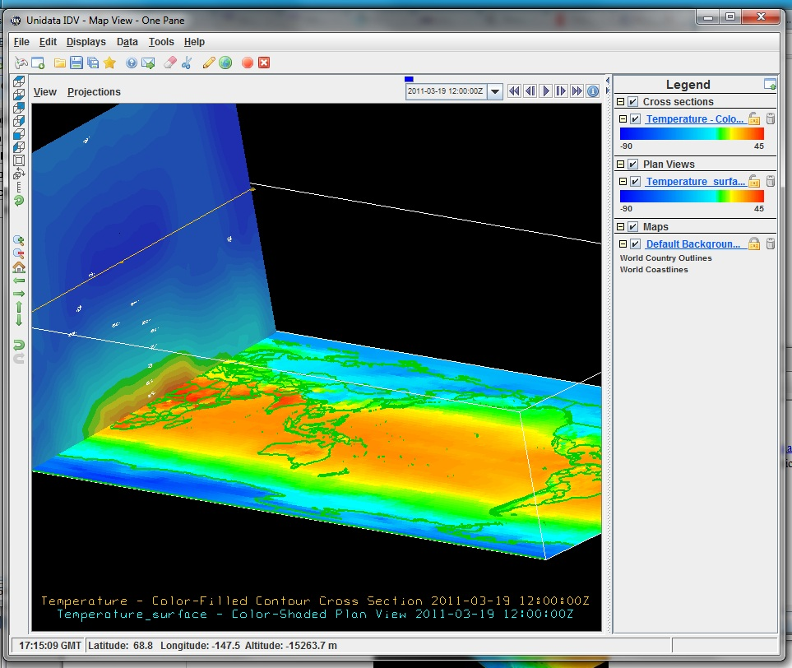
Embedded Links to Datasets and Desktop Applications

Slide 35
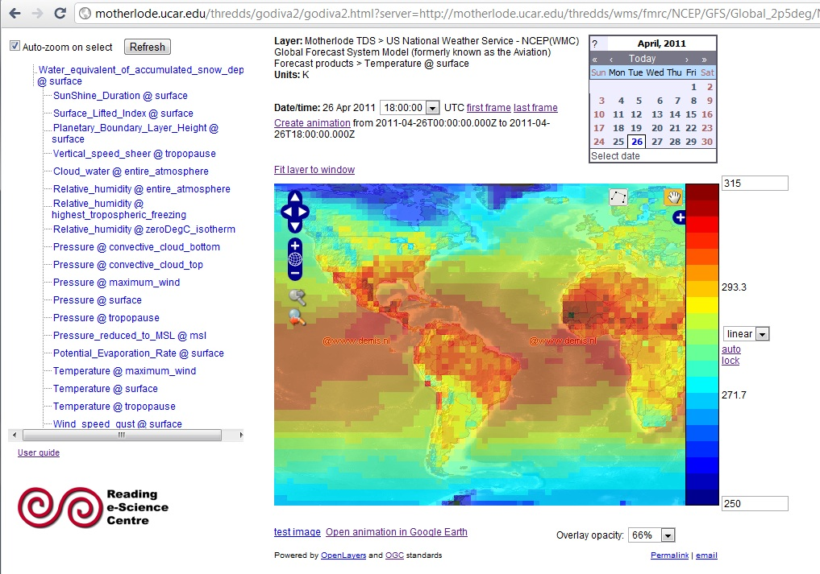
Interoperability and Collaboration
GFS 2.5 degree Surface Temperature
Forecast model output from US National Centers for Environmental Prediction
Real-time delivery via Unidata IDD
Stored in Unidata THREDDS Data Server motherlode
Dataset in
WMO GRIB2 files
Access via OGC WCS (Unidata), WMS (Reading e_Science), OPeNDAP (OPeNDAP Inc.), Unidata NetCDF Subset Service …
Unidata netCDF access via Unidata Common Data Model
Visualization via Reading GODIVA2
Hundreds of analysis and visualization tools work with Unidata netCDF datasets
Next slide

Slide 36
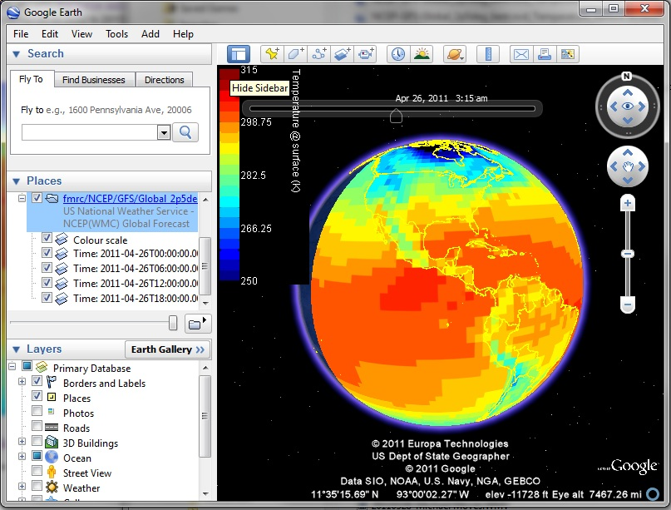
Google Earth Visualization
Created on Unidata TDS with e-Sciences WMS/GODIVA

Slide 37
Examples
General wiki-based publications at
https://sites.google.com/site/datainteractivepublications/
TDS/ncWMS motherlode example: http://motherlode.ucar.edu/thredds/godiva2/godiva2.html?menu=&layer=Temperature_surface&elevation=0&scale=205.9,306.3&bbox=-142.03125,-68.203125,37.96875,72.421875&server=http://motherlode.ucar.edu/thredds/wms/fmrc/NCEP/GFS/Global_2p5deg/NCEP-GFS-Global_2p5deg_best.ncd
Live Access Server example:
http://ferret.pmel.noaa.gov/NVODS/getUI.do?dsid=woa01_monthly&catid=0B541688EA4ACDF44451F0623AE315CF&varid=t0112an1
ERDDAP Example:
http://www.pfeg.noaa.gov/~cwilson/bloom/BW_14.html

