Slide 1

John Caron
Unidata
October 2012
And what are its plans for world domination?

Slide 2
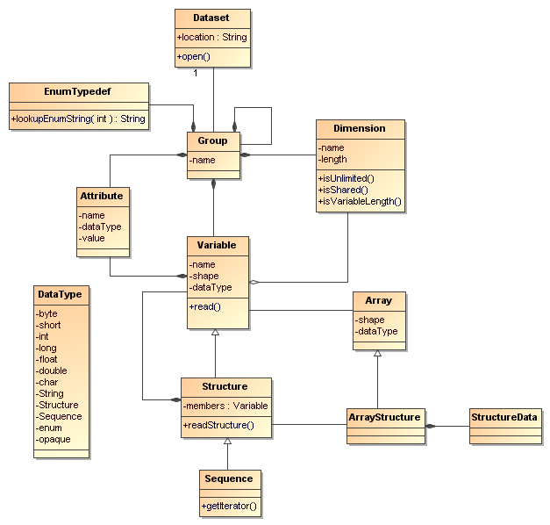
NetCDF is a…
File format
Store data model objects
Persistence layer
NetCDF-3, netCDF-4
Software library
Implements the API
C, Java, others
API
An API is the interface to the Data Model for a specific programming language
An Abstract Data Model describes data objects
and what methods you can use on them

Slide 3
NetCDF is a…
File format
Stores scientific data
Persistence layer
NetCDF-3, netCDF-4
Portable Format: Machine, OS, application independent
Random Access: fast subsetting
Simple: self-describing, user accessible“flat file”
Documented: NASA ESE standard, 1 page BNF grammer (netcdf-3)
Notes:
3

Slide 4
NetCDF-3 file format
Header
Non-record
Variable
Variable 1
float var1(z, y, x)
Row-major order
Variable 2
Variable 3 …
Record Variables
float rvar1(0, z, y, x)
Record 0
float rvar2(0, z, y, x)
float rvar3(0, z, y, x)
Record 1
float rvar1(1, z, y, x)
float rvar2(1, z, y, x)
float rvar3(1, z, y, x)
unlimited…

Slide 5
NetCDF-4 file format
Built on HDF-5
Much more complicated than netCDF-3
Storage efficiency
  Compression
  Chunking (can optimize for common I/O pattern)
  Multiple unlimited dimensions
  Variable length data

Slide 6
Row vs Column storage
Traditional RDBMS is a row store
  All fields for one row in a table are stored together
Netcdf-3 is a column store
  All data for one variable is stored together
Netcdf-4 allows both row and column store
  Row: compound type
  Column: regular variable
Recent commercial RDBMS with column oriented storage, better pergormance in some cases
  NetCDF-3 record variables are like a compound type

Slide 7
NetCDF is a…
Software library
Reference library in C
  Fortran, C++, Perl, Python, Matlab, …
Independent implementation in Java
others?
Open Source
Active community
Supported
No reference library, no user group for GRIB, BUFR
fragmented, not interoperable, difficult to use
Notes:
7

Slide 8
NetCDF is a…
API
The Application Programming Interface (API) is the interface to the Data Model for a specific programming language.
Clean separation of concerns
Information hiding – user never does a seek()
Stable, backwards compatible
Easily understood – no surprises
Interface has small “surface area”
Notes:
8

Slide 9
NetCDF is a…
An Abstract Data Model describes data objects and what methods you can use on them.
Notes:
9

Slide 10
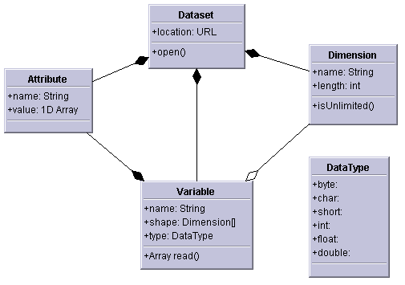
NetCDF-3 data model
Multidimensional arrays of primitive values
  byte, char, short, int, float, double
Key/value attributes
Shared dimensions
Fortran77

Slide 11
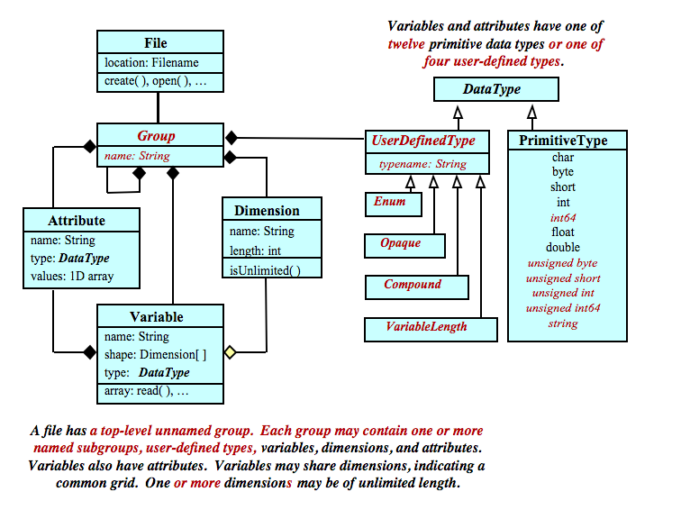
NetCDF-4 Data Model

Slide 12
NetCDF, HDF5, OPeNDAP
Data Models
Shared
dimensions
NetCDF (classic)
NetCDF (classic)
OPeNDAP
NetCDF (extended)
HDF5

Slide 13
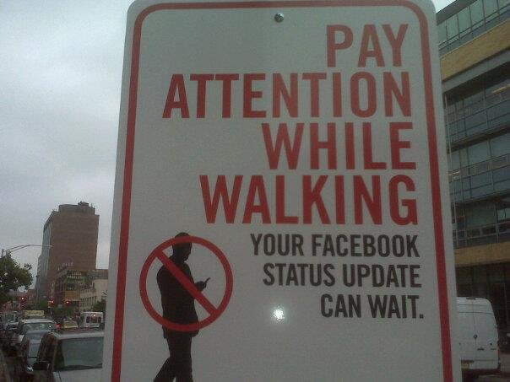
NetCDF-Java Library
(aka) Common Data Model
Status Update

Slide 14
C Library Architecture
Application
API
Dispatch
NetCDF-3
NetCDF-4
HDF5
HDF4
OPeNDAP
…

Slide 15
CDM Architecture
Scientific Feature Types
Application
Datatype Adapter
NetcdfDataset
NetCDF-Java/
CDM architecture
CoordSystem Builder
OPeNDAP
NetcdfFile
THREDDS
I/O service provider
Catalog.xml
NetCDF-3
NIDS
NcML
NetCDF-4
GRIB
cdmremote
HDF4
GINI
Remote Datasets
Nexrad
DMSP
…
Local Files

Slide 16
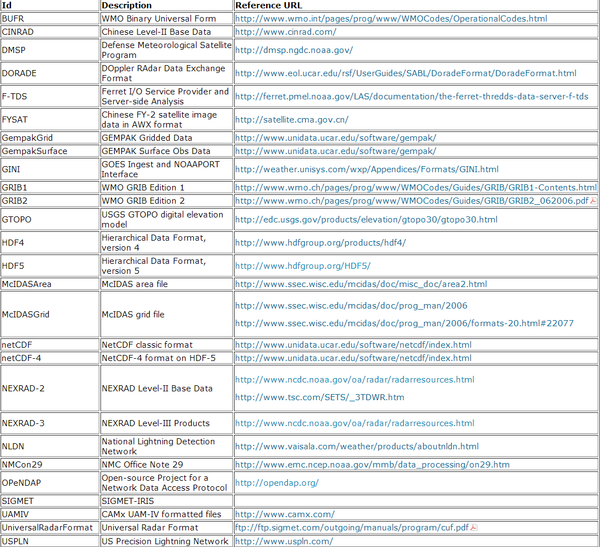
CDM file formats

Slide 17
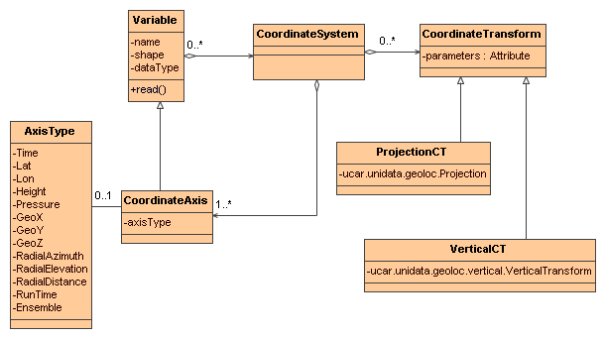
Coordinate System UML

Slide 18
Conventions
CF Conventions (preferred)
  dataVariable:coordinates = “lat lon alt time”;
COARDS, NCAR-CSM, ATD-Radar, Zebra, GEIF, IRIDL, NUWG, AWIPS, WRF, M3IO, IFPS, ADAS/ARPS, MADIS, Epic, RAF-Nimbus, NSSL National Reflectivity Mosaic, FslWindProfiler, Modis Satellite, Avhrr Satellite, Cosmic, ….
Write your own CoordSysBuilder Java class

Slide 19
Projections
albers_conical_equal_area (sphere and ellipse)
azimuthal_equidistant
lambert_azimuthal_equal_area
lambert_conformal_conic (sphere and ellipse)
lambert_cylindrical_equal_area (sphere and ellipse)
mcidas_area
mercator
METEOSAT 8 (ellipse)
orthographic
rotated_pole
rotated_latlon_grib
stereographic (including polar) (sphere and ellipse)
transverse_mercator (sphere and ellipse)
UTM (ellipse)
vertical_perspective

Slide 20
Vertical Transforms (CF)
atmosphere_sigma_coordinate
atmosphere_hybrid_sigma_pressure_coordinate
atmosphere_hybrid_height_coordinate
atmosphere_ln_pressure_coordinate
ocean_s_coordinate
ocean_sigma_coordinate
ocean_s_coordinate_g1, ocean_s_coordinate_g2
existing3DField

Slide 21
NetCDF “Index Space” Data Access:
  OPeNDAP URL:
  http://motherlode.ucar.edu:8080/thredds/dodsC/
  NAM_CONUS_80km_20081028_1200.grib1.ascii?
  Precipitable_water[5][5:1:30][0:1:77]
“Coordinate Space” Data Access:
  NCSS URL:
  http://motherlode.ucar.edu:8080/thredds/ncss/grid/
  NAM_CONUS_80km_20081028_1200.grib1?
  var=Precipitable_water&
  time=2008-10-28T12:00:00Z&
  north=40&south=22&west=-110&east=-80

Slide 22
Scientific Feature Types
Classification of earth science data into broad categories.
Take advantage of the regularities that are found in the data for performance
Scale to large, multifile collections
Support subsetting in Space and Time

Slide 23
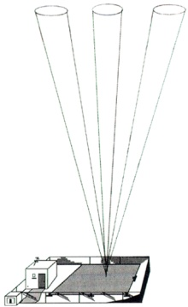
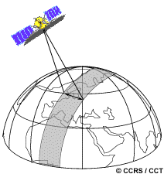
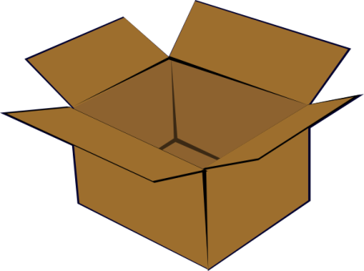
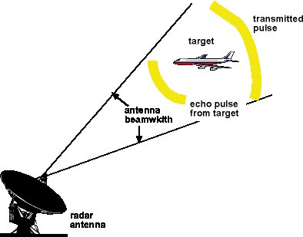
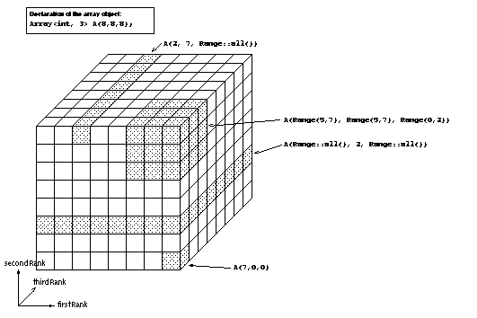

What’s in a file?
profile
swath
Feature Types
NetCDF File
OS File
radar
Multidimensional Arrays
Bag of Bytes

Slide 24
Gridded Data
Grid: multidimensional grid, separable coordinates
Radial: a connected set of radials using polar coordinates collected into sweeps
Swath: a two dimensional grid, track and cross-track coordinates
Unstructured Grids: finite element models, coastal modeling (under development)

Slide 25
Point Data
point: a single data point (having no implied coordinate relationship to other points)
timeSeries: a series of data points at the same spatial location with monotonically increasing times
trajectory: a series of data points along a path through space with monotonically increasing times
profile: an ordered set of data points along a vertical line at a fixed horizontal position and fixed time
timeSeriesProfile: a series of profile features at the same horizontal position with monotonically increasing times
trajectoryProfile: a series of profile features located at points ordered along a trajectory

Slide 26
Discrete Sampling Convention
CF 1.6
Encoding standard for netCDF classic files
  Challenge: represent ragged arrays efficiently
Classifies data according to connectedness of time/space coordinates
Defines netCDF data structures that represent features
Make it easy / efficient to
  Store collections of features in one file
  Read a Feature from a file
  Subset the collection by space and time

Slide 27
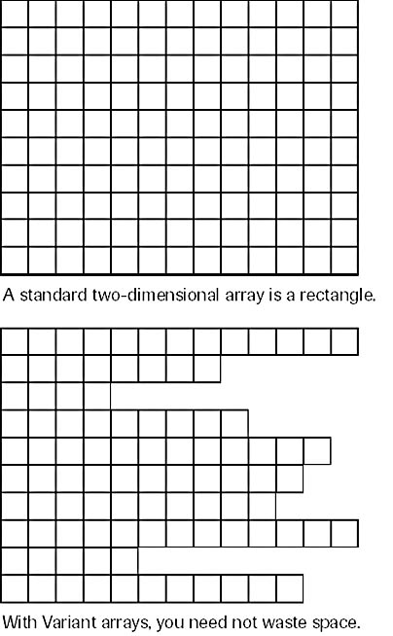
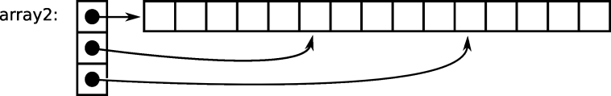
Ragged Array
Rectangular Array

Slide 28
NetCDF Markup Language (NcML)
XML representation of netCDF metadata (like ncdump -h)
Create new netCDF files (like ncgen)
Modify (“fix”) existing datasets without rewriting them
Create virtual datasets as aggregations of multiple existing files.
Integrated with the TDS
Notes:
Another component of the netCDF java library is support for the netCDF Markup Language. NcML is an XML representation of netCDF metadata. It can be used to create new netCDF files as well as modify an existing dataset and even aggregate a set of existing datasets.

Slide 29
THREDDS Data Server
Servlet Container
catalog.xml
Remote Access
Client
THREDDS Server
NCSS
OPeNDAP
HTTPServer
cdmremote
NetCDF-Java
library
configCatalog.xml
Datasets
IDD Data
motherlode.ucar.edu

Slide 30
Remote Access
OPeNDAP 2.0
  index space access
  Cant transport full netCDF extended data model
  Will replace with DAP 4 next year
cdmremote
  Full data model, index space access
Netcdf Subset Service
  coordinate space access to gridded data
  Delivers netCDF files (also csv, xml, maybe JSON)
  Now writes netcdf-4 (alpha test), with C library / JNI
cdmrFeature Service
  coordinate space access to point data
  Feature type API

Slide 31
ncstream serialization
message
message
message
…
message
…
message
message
message
message
message
message
…
message
…
message
message
message
index

Slide 32
CDM Architecture
Scientific Feature Types
Application
Datatype Adapter
NetcdfDataset
NetCDF-Java/
CDM architecture
CoordSystem Builder
OPeNDAP
NetcdfFile
THREDDS
I/O service provider
Catalog.xml
NetCDF-3
NIDS
NcML
NetCDF-4
GRIB
cdmremote
HDF4
GINI
Remote Datasets
Nexrad
DMSP
…
Local Files

Slide 33
CFSR timeseries data at NCDC
Climate Forecast System Reanalysis
1979 - 2009 (31 years, 372 months)
Total 5.6 Tbytes, 56K files
Grib2 data

Slide 34
GRIB collection indexing
GRIB file
1000x smaller
Index file
name.gbx9
TDS
Create
GRIB file
Collection Index
collectionName.ncx
Index file
name.gbx9
1000x smaller
CDM metadata
…
GRIB file
Index file
name.gbx9

Slide 35
GRIB time partitioning
GRIB file
gbx9
GRIB file
ncx
gbx9
TDS
…
GRIB file
gbx9
Jan 1983
GRIB file
Partition index
Collection.ncx
gbx9
GRIB file
ncx
gbx9
…
GRIB file
gbx9
Feb 1983
…
Mar 1983
…

Slide 36
What have we got ?
Fast indexing allows you to find the subsets that you want in under a second
  Time partitioning should scale up as long as your data is time partitioned
No pixie dust: still have to read the data!
GRIB2 stores compressed horizontal slices
  decompress entire slice to get one value
Experimenting with storing in netcdf-4
  Chunk to get timeseries data at a single point

Slide 37
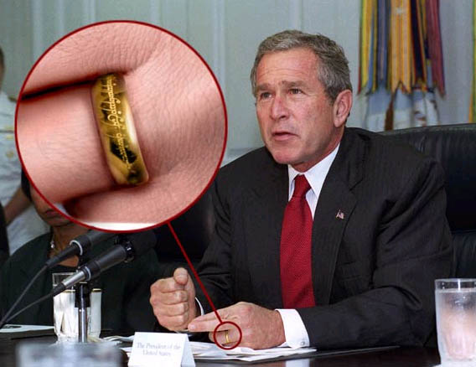
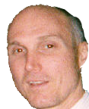

Slide 38
Big Data

Slide 39
Bigger Data
CMIP5 at IPSL Climate Modelling Centre
  300K netCDF files, 300 Tb.
Sequential read of 300 Tb @ 100Mb/sec
  3 x 10^6 sec = 833 hours = 35 days
How to get that down to 8 hours ?
  Divide into 100 jobs, run in parallel

Slide 40
Required: Parallel I/O Systems
Shared nothing, commodity disks
Fault tolerant, replicated data (3x)
Google File System using map/reduce
  Hadoop is open source implementation
Wide industry use
Cost
  $3000 per node TCO per year
  $300K per year for 100 node cluster
  Cost will continue to fall
  Not sure if you should rent or buy

Slide 41
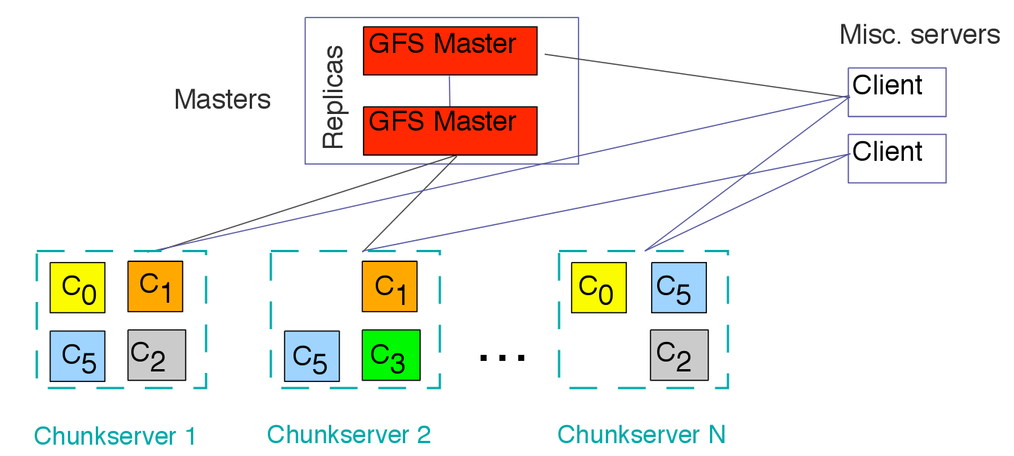
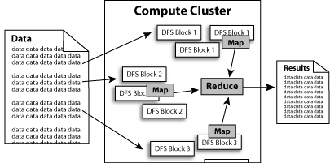
Parallel File I/O
Google File System
Hadoop

Slide 42
Required:
Send User programs to server
Need a query / computation language
  easily parallelized
  scientists can/will use
  Powerful enough to accomplish hard tasks
What language?
  Not going to retrofit existing Fortran code
    Remember, this is post-processing, not model runs
  Not Fortran, C, Java (too low level)
  Some subset of Python ?

Slide 43
Send User programs to server
Probably a Domain Specific Language (DSL)
  Make it up for this specific purpose
  But make it familiar!
  So it could look like some subset of existing language

Slide 44
Existing Candidates
SciDB just proposed ArrayQL:
“ArrayQL currently comprises two parts: an array algebra, meant to provide a precise semantics of operations on arrays; and a user-level language, for defining and querying arrays. The user-level language is modeled on SQL, but with extensions to support array dimensions.”
Google Earth Engine is developing a DSL

Slide 45
Required: Parallelizable
High Level Language
Scientific Data Management in the Coming Decade, Jim Gray (2005)
Now: File-at-a-time processing in Fortran
Need: Set-at-a-time processing in HLQL
Declarative language like SQL (vs. procedural):
Define dataset subset to work against
Define computation
Let the system figure out how to do it

Slide 46
NetCDF “Index Space” Data Access:
  OPeNDAP URL:
  http://motherlode.ucar.edu:8080/thredds/dodsC/
  NAM_CONUS_80km_20081028_1200.grib1.ascii?
  Precipitable_water[5][5:1:30][0:1:77]
“Coordinate Space” Data Access:
  NCSS URL:
  http://motherlode.ucar.edu:8080/thredds/ncss/grid/
  NAM_CONUS_80km_20081028_1200.grib1?
  var=Precipitable_water&
  time=2008-10-28T12:00:00Z&
  north=40&south=22&west=-110&east=-80

Slide 47
“Coordinate Space” Data Access:
  http://motherlode.ucar.edu:8080/thredds/ncss/grid/
  NAM_CONUS_80km_20081028_1200.grib1?
  var=Precipitable_water&
  time=2008-10-28T12:00:00Z&
  north=40&south=22&west=-110&east=-80
Fake SQL:
SELECT Precipitable_water
  FROM NAM_CONUS_80km_20081028_1200.grib1
  WHERE time=2008-10-28T12:00:00Z
  AND space=[north=40,south=22,west=-110,east=-80]

Slide 48
More Elaborate
  DATASET cfsr
  FROM CFSR-HPR-TS9
  WHERE month=April AND year >= 1990
  AND space=[north=40,south=22,west=-110,east=-80]
  AS Grid
  SELECT precip=Precipitable_water, rh=Reletive_Humidity, T=Temperature
  FROM cfsr
  CALC DailyAvg(Correlation( precip, rh) / Avg(T))
  RETURN AS Grid

Slide 49
APL example
  DATASET cfsr
  FROM CFSR-HPR-TS9
  WHERE month=April AND year >= 1990
  AND space=[north=40,south=22,west=-110,east=-80]
  AS Grid
  CALCDEF myCalc (X,Y,DATA) {
  X ← 3 3⍴÷⍳9 ⋄ Y ← DATA[⍋DATA] }
  SELECT precip=Precipitable_water, rh=Reletive_Humidity, T=Temperature
  FROM cfsr
  CALC myCalc(precip, rh, T)
  RETURN AS Grid

Slide 50
Summary: Big Data Post-Processing
Need parallel I/O System
  Shared nothing, commodity disks, replicated data
Need parallel processing system
  Hadoop based on GFS (Map/reduce)
Need to send computation to the server
Need a parallelizable query / computation language
  Possibly declarative
  Must be expressive and powerful
  Probably a new “domain specific” language
  Need to capture common queries

