Slide 1

NAWIPS Migration to AWIPS II
Unidata Users Committee Meeting
NCEP Central Operations
April 2, 2012

Slide 2


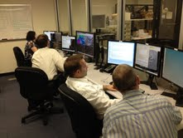
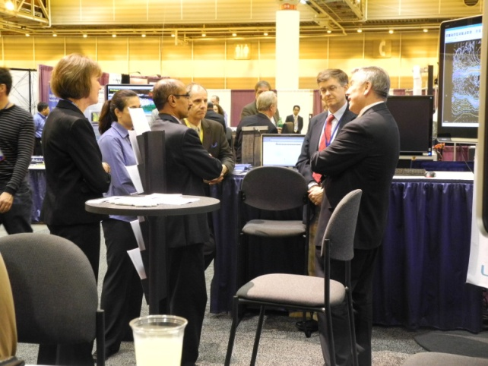
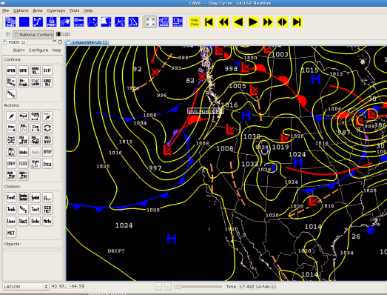
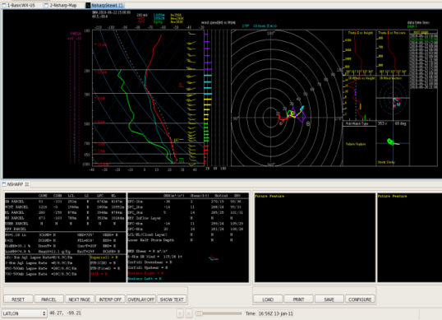
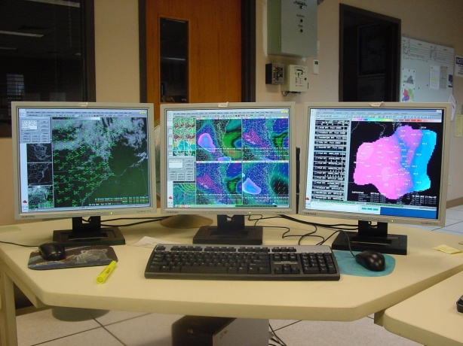
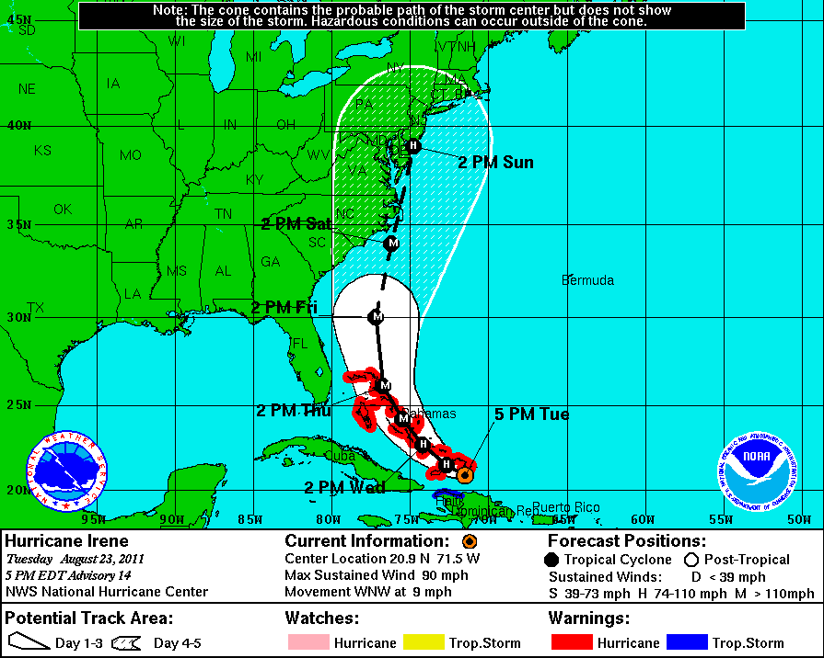

NAWIPS/AWIPS II Activities
Since October
Phase II FIT
AMS
GUI Migration
Code Integration
FOTE
AWIPS I to AWIPS II
GEMPAK
6.5 & 6.6
64-bit
wkstn
2
AWIPS II Status – Unidata Users Committee April 2012
Notes:
Most NAWIPS GUI functionality has been ported to AWIPS II CAVE National Center Perspective (NCP)
Phase II of the Forecaster Integration Testing (FIT) occurred from November 2011 – February 2012
Most NCEP Centers are using 64-bit CAVE workstations during FOTE
Field Operational Testing and Evaluation (FOTE) has started for AWIPS I migration to AWIPS II at six NCEP Centers
NCO partnered with Unidata at the AMS Conference in New Orleans to provide AWIPSII / NCP demonstrations
NCP code has been re-integrated into AWIPS OB12.2.1
GEMPAK software V6.5.0 released in January 2012
GEMPAK V6.6.0 will be released this week

Slide 3
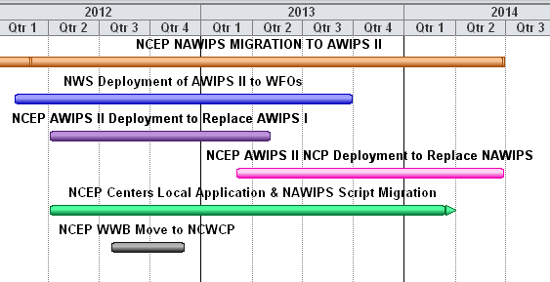
AWIPS II “Big Picture”
Migration Schedule
AWIPS I to AWIPS II
  WWB NCEP Centers have signed off on AWIPS II to replace AWIPS I
  AWC and SPC are both in FOTE and plan to remove AWIPS I in June/July 2012
  NHC does not enter FOTE until December and SWPC does not have AWIPS I
NAWIPS to AWIPS II
  Transition will occur on a Center-by-Center basis
  Climate Prediction Center is expected to transition during Winter 2013
Oct
Oct
Oct
3
AWIPS II Status – Unidata Users Committee April 2012

Slide 4
Let’s Compare…
AWIPS I Schedule
APRIL 2011 Unidata Users Committee Meeting
NWS AWIPS II | Schedule
System OTE | Jan – July 2011
Field OTE including National Centers | July – October 2011
Begin National Deployment (WFOs + NCs) | October 2011
Unidata to Receive AWIPS II | Winter 2011
APRIL 2012 Unidata Users Committee Meeting
NWS AWIPS II | Schedule
System OTE | Jan – November 2011
Field OTE including National Centers | Nov 2011 – June 2013
Begin National Deployment (WFOs + NCs) | Combined with FOTE above
Unidata to Receive AWIPS II | Winter 2011
Unidata Users to Receive AWIPS II | Spring 2013
4
AWIPS II Status – Unidata Users Committee April 2012

Slide 5
Let’s Compare…
NAWIPS Schedule
APRIL 2011 Unidata Users Committee Meeting
NWS AWIPS II NCP | Schedule
NCP Code Baselined in AWIPS II by RTS | May 2011
Forecaster Integration Testing Schedule (Phases One / Two / Three) | Feb 2011 / June 2011 / unknown
Establishing Non-SBN Data Flow to AWIPS II | Proposed method submitted
Removal of NAWIPS at NCEP Centers | Finished by September 2012
APRIL 2012 Unidata Users Committee Meeting
NWS AWIPS II NCP | Schedule
NCP Code Baselined in AWIPS II by RTS | January 2012
Phase One / Phase Two FIT / Phase Three | Feb 2011 / Nov 2011 / Oct 2012
Establishing Non-SBN Data Flow to AWIPS II | Oct 2011 (NTBN) / June 2012
Removal of NAWIPS at NCEP Centers | Jan – Dec 2013
5
AWIPS II Status – Unidata Users Committee April 2012

Slide 6
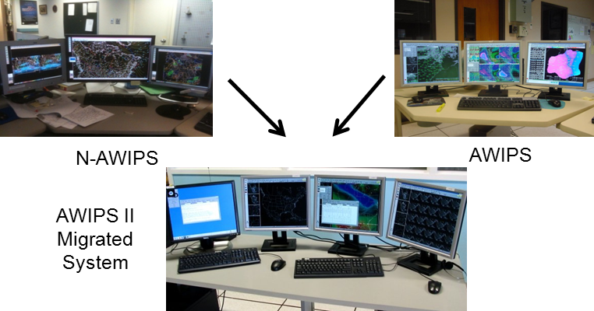
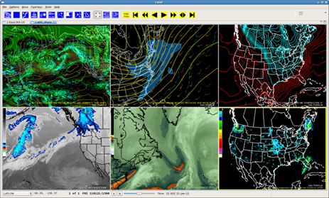
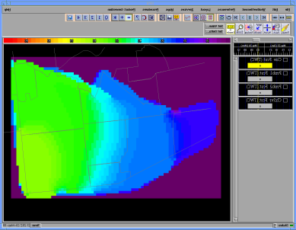



AWIPS II Migration
Risk Assessment
  The overall migration effort has taken significantly longer than originally planned at both the NWS and NCEP levels
Delays in the National Migration Program have resulted in delays in the NCP migration and integration of the code by Raytheon
32-bit vs. 64-bit requirement lies mostly with NCP data set size and usage, and the Gridded Forecast Editor (GFE)
NCP Performance
NCWCP Move
6
AWIPS II Status – Unidata Users Committee April 2012
Notes:
The overall migration effort has taken significantly longer than originally planned at both the NWS and NCEP levels
Until last Fall … the AWIPS II software baseline has been a moving target
Delays in the National Migration Program have resulted in delays in the NCP migration and integration of the code by Raytheon
32-bit vs. 64-bit requirement lies mostly with NCP data set size and usage, and the Gridded Forecast Editor (GFE)
The move to the NCWCP will occur this year
Some personnel redirected to support the move
Performance is the final task in our migration effort - NWS AWIPS Program has created a task for Raytheon to assist NCO in evaluation and solving the performance issues

Slide 7
Status of
Trouble Ticket Reports
As of 26 March 2012
407 TTRs Open
267 CHM - Critical (78), High (76), Major (113)
128 Ready for Retest
0 Not adjudicated
Projected “fix rate” of 10 per week, 5 per week during move to NCWCP
NHC, SPC
CPC, PR, Unidata
AWC
HPC, OPC, NESDIS, SDM, NHC
TTRs Classified as Critical / High/ Major (CHM)
Repeatable problem that prevents or compromises the delivery of products or services
Critical - No alternate solution is available.
High - A temporary workaround is available, but is too cumbersome or workload intensive to sustain operations.
Major - A workaround is available to allow continuation of operations; however, workaround not acceptable for software acceptance.
7
AWIPS II Status – January 2012
Notes:
7

Slide 8
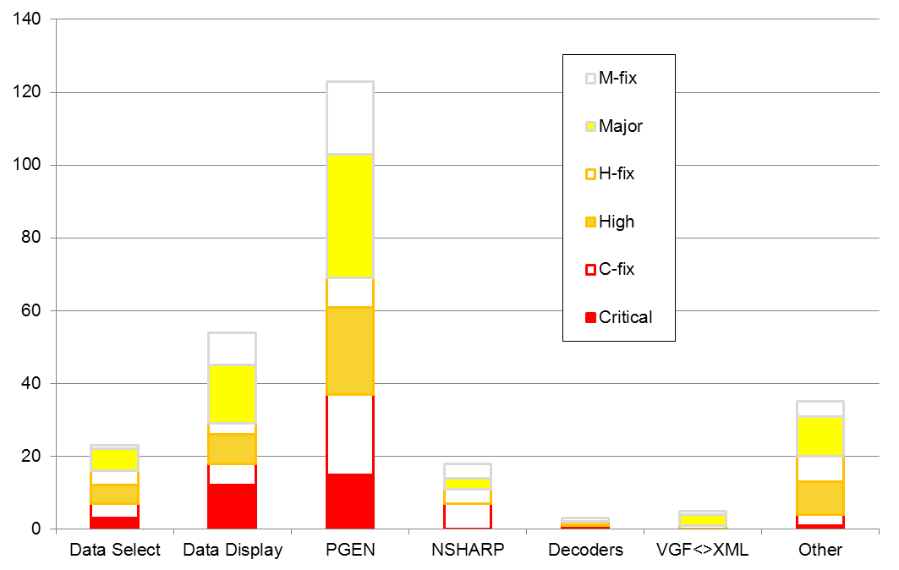
Distribution of
Trouble Ticket Reports
TTRs Classified as Critical / High / Major (CHM)
Repeatable problem that prevents or compromises the delivery of products or services
Critical - No alternate solution is available.
High - A temporary workaround is available, but is too cumbersome or workload intensive to sustain operations.
Major - A workaround is available to allow continuation of operations; however, workaround not acceptable for software acceptance.
8
AWIPS II Status – Unidata Users Committee April 2012
Notes:
8

Slide 9
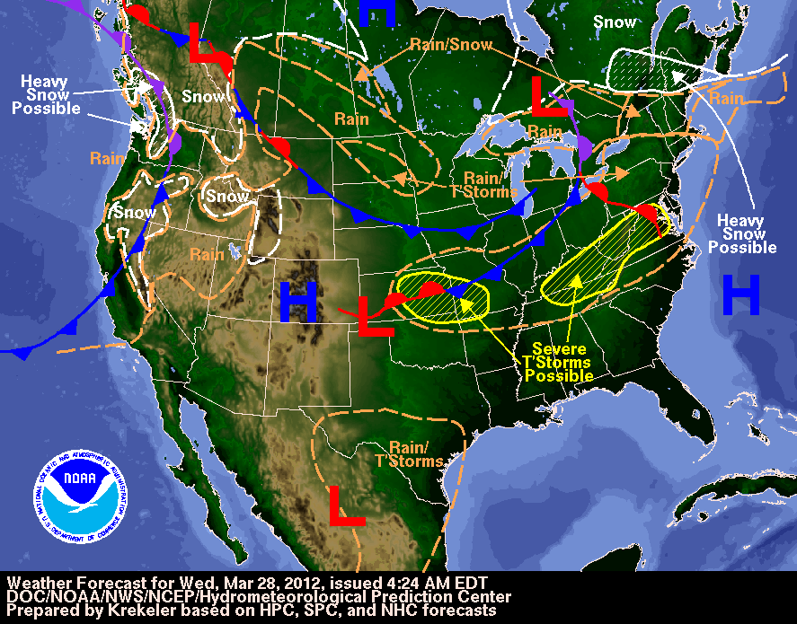
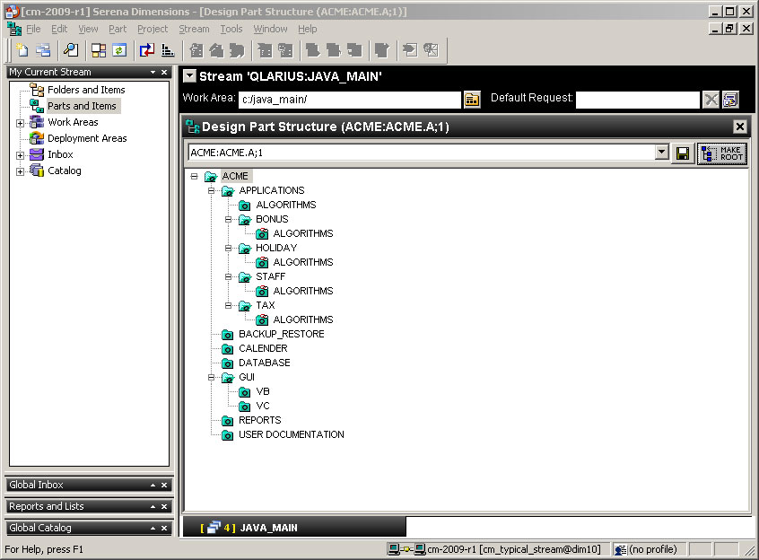
AWIPS II / GEMPAK
Software Release Guidelines
GEMPAK will be considered a
“local application” for AWIPS II
  NCO will continue to support GEMPAK code indefinitely /until further notice
  Routines are being reworked to ensure the GEMPAK libraries can read data from either the AWIPS II Data Base or GEMPAK format files
NCO will be uploading NCP to the AWIPS II baseline on a monthly basis
NCO mirrors RTS code from Dimensions (CM Tool) in Silver Spring
Beginning with release 12.4.1, NCO anticipates the NCP code integrated with RTS code on a monthly basis
Typically the NCP code will lag about 6 weeks
9
AWIPS II Status – Unidata Users Committee April 2012

Slide 10
AWIPS II Release Schedule
Software Released from AWIPS Program on a monthly basis
Release | Date
12.3.1 | April 4, 2012
12.4.1 (NCP from 3/27) | May 2, 2012
12.5.1 | May 29, 2012
12.6.1 | June 26, 2012
12.7.1 | July 25, 2012
12.8.1 | August 22, 2012
12.9.1 | September 24, 2012
12.10.1 | October 22, 2012
12.11.1 | November 19, 2012
12.12.1 | December 17, 2012
13.1.1 | January 17, 2013
10
AWIPS II Status – Unidata Users Committee April 2012

Slide 11
GEMPAK / AWIPS II
DB Compatibility Schedule
CAVE is currently able to read GEMPAK gridded files
NCEP Centers are expected to convert scripts to use AWIPS II formatted files from the PostGRES Data Base
Currently…XML files created via PGEN will need to be converted to VGF (for generating other output files) until a GEMPAK XML reader is created (gpmap)
GEMPAK function to read AWIPS II PG Database | Fiscal Year / Quarter
GDFILE | Completed
SFFILE | FY12Q4
SNFILE | FY12Q4
SATFILE / RADFILE | FY13Q1
XML Driver | FY13Q1
MISC Data Sets | FY13Q2
GeoTIFF Driver | FY13Q2
11
AWIPS II Status – Unidata Users Committee April 2012

Slide 12
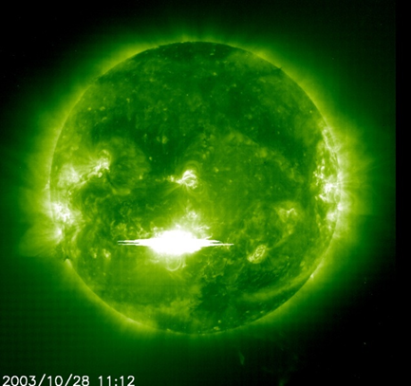
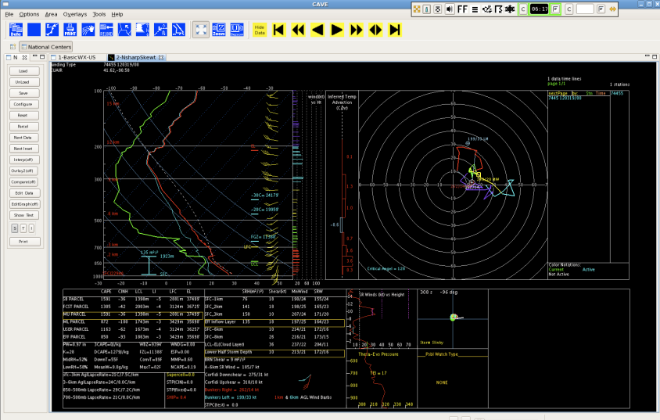
Planned AWIPS II
FY12Q3 Tasks
Requirement
Performance issues NCP startup - Certain areas of the data selection / data display - High resolution shape files
SWPC GOES/NASA Stereo/NASA SOHO Imagery IOC
NSHARP DR fixes as needed
Continued TTR fixes to the NCP, scheduling based on priority assignment of TTR Review Team - AWC NSHARP functionality for turb, icing and cloud value based display, attributes, Filtering for point data resources - Zoom and pan synchronization between displays - Obs missing from NCTEXT
Set up Non-SBN Data Flow to NCEP AWIPS II
12
AWIPS II Status – Unidata Users Committee April 2012

Slide 13
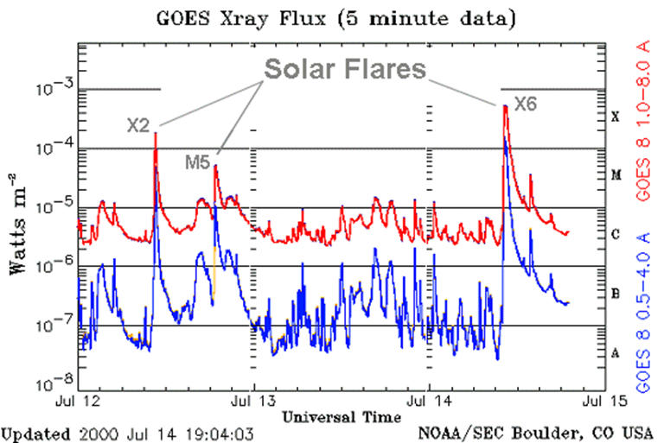
Planned AWIPS II
FY12Q4 Tasks
Requirement
SWPC high-frequency data decoder
AWC NSHARP time-height wind profile display
Continued TTR fixes to the NCP, scheduling based on priority assignment of TTR Review Team - Background overlays for all Centers, with documentation SPF/RBD management - Map and overlay management - PGEN grid import to Contour Tool - Generalized configuration of NCP
13
AWIPS II Status – Unidata Users Committee April 2012

Slide 14
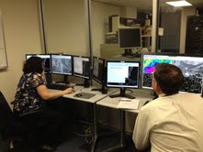
Forecaster Integration Test
Status
Phase Two:
  Duration: November 28, 2011 – February 24, 2012 - concluded
  All NCEP Centers, Unidata, and NWS Pacific Region tested on the NTBN
  Pros:
      Almost all of centrally supported functionality can be tested
      Significant progress made with Product
      Multiple Product Generation sessions are allowed
      Progressive disclosure of data
      Multi-panel display capabilities
  Challenges:
      Performance – several areas significantly slower than NAWIPS
      CAVE crashes do occur
        these are NOT system/server crashes
        probable memory issues due to 32-bit architecture limitations
14
AWIPS II Status – Unidata Users Committee April 2012

Slide 15
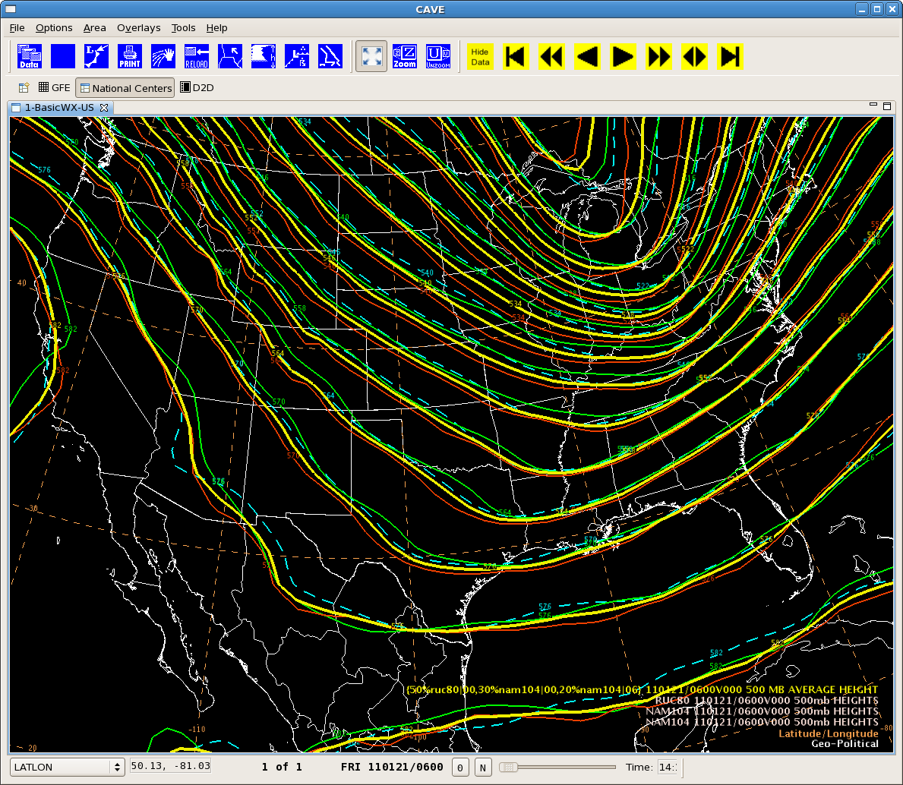
National Center Perspective Performance Status
Significant focus is now on addressing the performance issues
Primary areas of concern:
  NCP startup
  Data selection
  Database acquisition of some datatypes
  Display of some datatypes
OST has authorized a Raytheon Work Assignment to help identify causes and offer solutions
  Some solutions may involve core architecture, SIB approach, or a combination of both
15
AWIPS II Status – Unidata Users Committee April 2012
Notes:
15

Slide 16

National Center Perspective Performance Status
Some issues already solved and ready for re-evaluation
Example – NSHARP data access
  Observed Sounding (NcUair plugin), 30 profile query:
    Before: 40 seconds or ~ 1.3 second/profile
    Now: ~2.5 seconds or ~ 0.1 second/profile
  PFC (modelsounding plugin), 30 profile query:
    Before: ~1 min or 2 sec/profile
    Now: ~0.5 second or ~17 ms/profile
Example – Gridded data display
  Multi-threading of code has shortened load time significantly
  Needs further testing, timing and evaluation (particularly with 64-bit)
  Current grid loading performance metrics
    CAVE accessing A2DB, 20 frames 200mb HGHT, VEL, WIND – 15 sec
      At the start of the Phase 2 FIT – 20 sec
    CAVE accessing GEMPAK, same as above – 12 sec
    NMAP, same as above – 8.5 sec
16
AWIPS II Status – Unidata Users Committee April 2012
Notes:
16

Slide 17
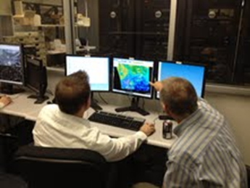
AWIPS II Training
NCO will conduct a webinar in late April to provide an overview and variance briefing for the National Center Perspective
  Open for all Academia
  Session will be taped and available via Unidata web site
NCO-provided Training (NCP-based)
  System Overview Presentation by NCO – Completed
  General System Topology by NCO – Completed
  NCP/AWIPS II User Interface Introduction – Completed
Open the NCO Test Bed for Unidata Community for training purposes – “train the trainers” – Completed
AWIPS II Documentation will be provided by Raytheon
17
AWIPS II Status – Unidata Users Committee April 2012
Notes:
17

Slide 18
NWS Training Division
Training Division has developed a series of modules on AWIPS2 training
  They are available via NWS page at Commerce Learning Center at: https://doc.learn.com/
AWIPS2 modules are organized under a dedicated page with link from NWS CLC home page:
AWIPS-2 Transition Training is now available.
Please visit the AWIPS-2 Transition Training Page for more information.
Select Unidata staff has access to the CLC and are able to take the AWISP2 training
Contact: Tony Mostek: anthony.mostek@noaa.gov / 303-497-8490
18
AWIPS II Status – Unidata Users Committee April 2012
Notes:
18

Slide 19
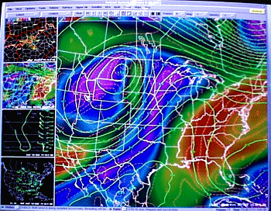
AWIPS II Extended Projects
Thin Client Project Overview
Objective:
  Allows AWIPS remote access
Status:
  Prototyping and system analysis of AWIPS II SOA: Completed
  Production development: In progress, testing being conducted
  Deployment to be staged with AWIPS II deployment
Schedule/Milestones:
  Thin Client Testing at Boulder CWSU: February, 2012
  IOC Deployment Target: 3QFY12
  FOC Deployment Target: Q1FY13
19
AWIPS II Status – Unidata Users Committee April 2012
Notes:
19

Slide 20
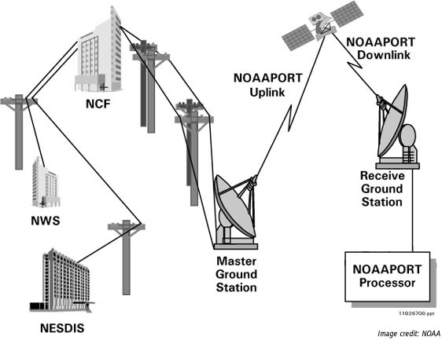
AWIPS II Extended Projects
Data Delivery Project Overview
Objective:
  Develop operational robust infrastructure to support “intelligent” access to non-local data provider datasets
Status:
  CONOPS/Technical Requirements: Complete for IOC
  High-level architecture/design, technical requirements, bandwidth analyses: Complete
  IOC Production design and incremental development: In progress
Schedule/Milestones:
  Initial Development Release: April, 2012
  IOC Deployment Target: Q4FY13
  FOC Deployment Target: Q1FY15
20
AWIPS II Status – Unidata Users Committee April 2012
Notes:
20

Slide 21
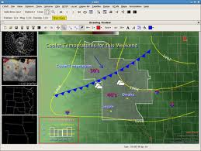
AWIPS II Extended Projects
Collaboration Project Overview
Objective:
  Improve our ability to communicate NWS forecasts to customers and partners so that the appropriate response is generated
Status:
  Requirements and prototyping for internal collaboration (Phase I): Complete
  Production design and development (Phase 1): In progress
  Phase II (External Collaboration) requirements definition: In progress
Schedule/Milestones
  Initial Resource Plan and Schedule: January, 2012 (Complete)
  IOC Deployment Target: Q4FY12
  FOC Deployment Target: Q1FY15
21
AWIPS II Status – Unidata Users Committee April 2012
Notes:
21

Slide 22

Unidata Involvement
Unidata is actively engaged with the AWIPS Program
Weekly Migration Telecons have continued over the past year and Unidata will now participate on all monthly NCEP AWIPS II Status briefs
AWIPS II migration efforts high priority of NWS through FY13
SIB is committed to assisting in software configuration and training forecasters and key personnel at Unidata in FY12 and FY13
NCEP continues to view Unidata as a critical partner for NCEP’s total mission
22
AWIPS II Status – Unidata Users Committee April 2012
Notes:
22

Slide 23
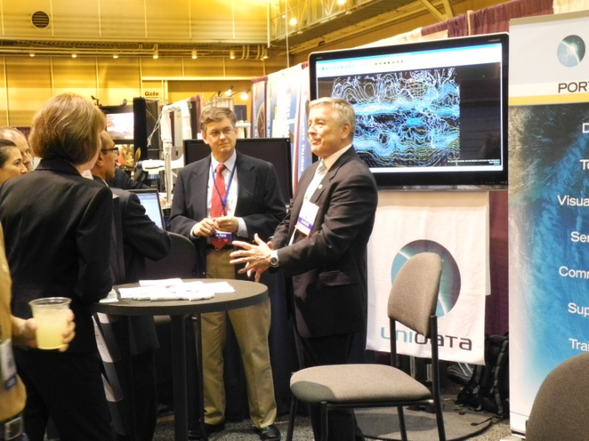
Final Thoughts…
NCEP is committed to our partnership with Unidata and the entire Unidata Community
Despite slips in our migration schedule, NCEP is focused on delivering software that is reliable, stable, and expandable to meet the needs of our partners for the years to come
National Center Perspective Overview will be given by NCEP AWIPS2 Development Team Lead David Plummer in late April 2012, date and time TBD
23
AWIPS II Status – Unidata Users Committee April 2012

