Slide 1

N-Wave Stakeholder Users Conference
Wednesday, May 11, 2011
3645 Marine St, Rm 123
Boulder, CO
Linda Miller and Mike Schmidt
Unidata Program Center (UPC)-Boulder, CO

Slide 2
Unidata: An Overview
Who are we?
Who benefits?
What data?
What tools?
How does this work? (hint-Collaboration)

Slide 3
Unidata – Who are we?
Unidata’s mission:
To provide data, tools, and community leadership for improving Earth-system education and research
To accomplish this, we:
  Develop data access infrastructure
  Develop open source tools for data access, analysis, visualization, and management
  Leverage network resources available through NCAR’s networking and the Front Range Gigapop
  Support faculty, students, and researchers
  Rely on primary funding from the National Science Foundation
Notes:
Although the main focus of our work is on providing real-time data, Unidata develops tools, middleware, and services that contribute to broader cyberinfrastructure needs of the community.
We couldn’t do what we do without Marla’Meehl’s networking group and Front Range Gigapop!

Slide 4
Unidata – Who Benefits, and How?
We serve the education and research community by:
  Providing freely available data and software tools
  Building an Open Source development community to develop and extend Unidata tools
  Modeling software development best practices
  Encouraging collaboration between community members
  Advocating on behalf of community members for access to scientific data
Notes:
Did I say FREE?
Linux developer Linus Torvals
netCDF has a diverse community of developers – many in government agencies

Slide 5
Unidata – Access to Data
The Internet Data Distribution (IDD) System
  IDD delivers near-real time data: model outputs, surface, radar, upper-air, satellite observations, lightning, aircraft, mesonet data and more
  IDD is a worldwide collaboration of universities, government agencies and other research institutions
  Unidata develops the IDD software, provides support and training, negotiates data agreements, and collaborates with its community and governing committees
Notes:
Back around 1994 or 5, we developed the Internet Data Distribution

Slide 6
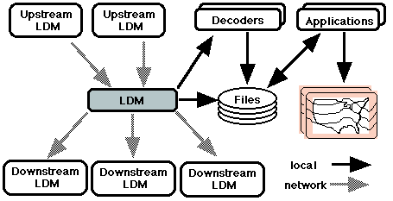
Unidata’s Local Data Manager (LDM)
The heart of the Internet Data Distribution System
A reliable, event-driven alternative to FTP for data distribution
Protocols and client-server software for capturing, distributing, and organizing data in near-real time
Redundant feeds provide reliability in case of “upstream” failures
Highly configurable: can inject, distribute, capture, filter, and process arbitrary data products
Supports subscriptions to subsets of data feeds
Notes:
Not a data center
Similar to subscribing to twitter or blogs – you receive data/information whenever it becomes available

Slide 7
Internet Data Distribution
Source
LDM
LDM
LDM
Source
Source
LDM
LDM
LDM
LDM
LDM
Internet
LDM
Pushes data from multiple sources using cooperating LDMs
Over 250 institutions on 5 continents and growing
Notes:
IDD and LDM are inextricably related when it comes to Unidata’s real time data distribution.

Slide 8
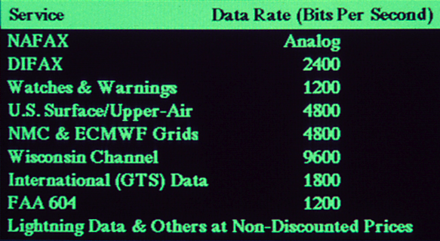
LDM/IDD Real-Time Data Flows
In the Beginning...
…Today
LDM-6 handles 15 GB/hour input, with as many as 280,000 products/hour
LDM-6 collects data for THORPEX Interactive Grand Global Ensemble (TIGGE)
Cluster LDM configurations handle 600+ downstream connections
Over 450 LDM machines run continuously at 250 sites
NWS uses LDM-6 operationally to collect and relay NEXRAD level 2 data from over 162 radars
“a dizzying volume of information – on the order of 100 MBytes/day” (AMS paper on LDM-2, Davis and Rew, 1990)

Slide 9
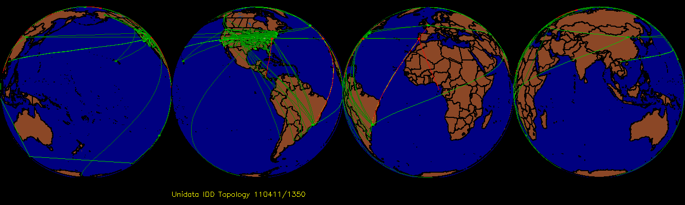
UPC Data Flows
The Unidata Program Center’s IDD/LDM Cluster:
Receives ~15 GB/hour from upstream sites
Relays data to more than 650 downstream
connections.
Has average data throughput of day: 5.7 TB/day
(525 Mbps!)
Peak data throughput rate exceeds 1.1 Gbps
Notes:
Many more organizations are using the LDM – not reporting RT stats to Unidata
CONDUIT and WSR-88D Level II data are the biggest data sets we have –
CONDUIT - 42.8%, NEXRAD Level II data - 22.8%

Slide 10
Data Requirements
Assumptions
Data Available to AWIPS, NCEP, and the Gateway
Dual-Pol
GOES-R
GOES-S
NPP
* Note: Volume of other products (e.g. METARS) is negligible
Notes:
Observing Systems and Models are driving bandwidth growth
Exponential growth over the next decade
IT Infrastructure Plan Supports Enabling the forecaster for Day 1 products
Cannot build anything more due to limitations
Planning vision
Cannot afford anything else in this fiscal environment

Slide 11
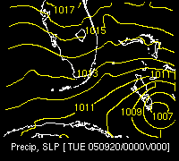
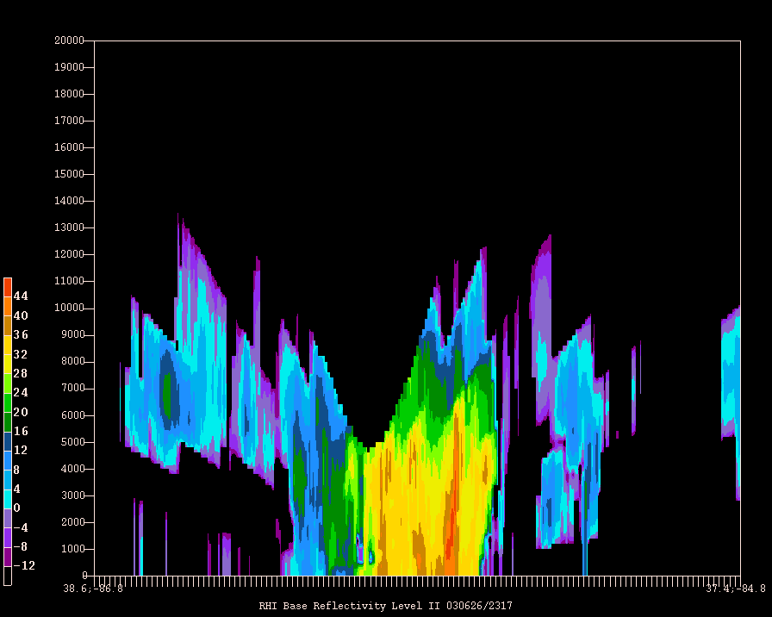
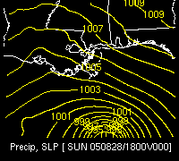
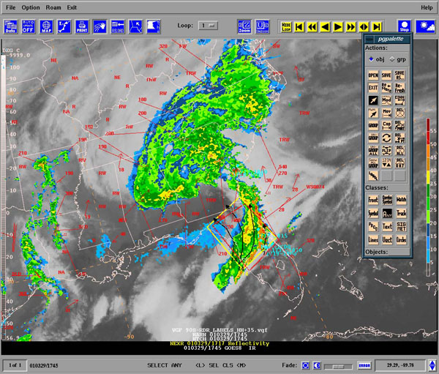
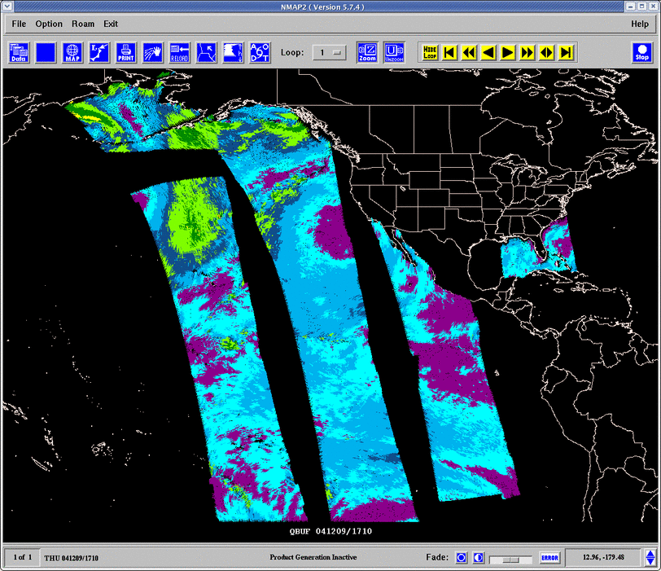
GEneral Meteorology PAcKage
GEMPAK
Notes:
Eventually transitioning to AWIPS II

Slide 12
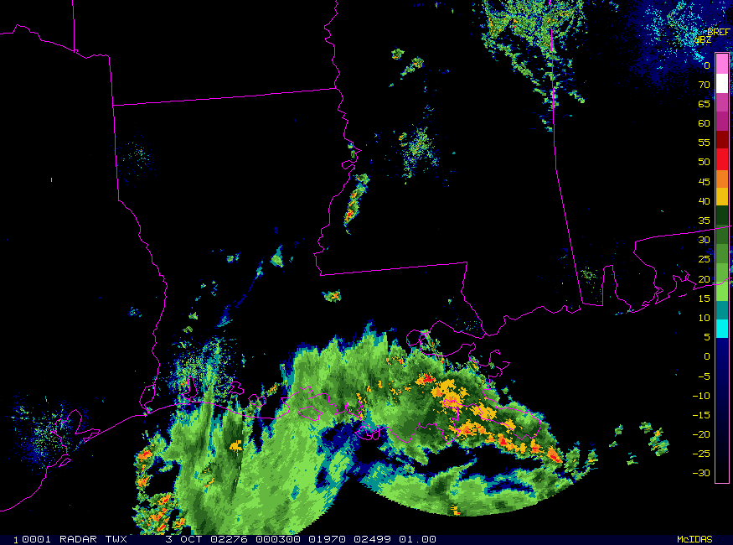
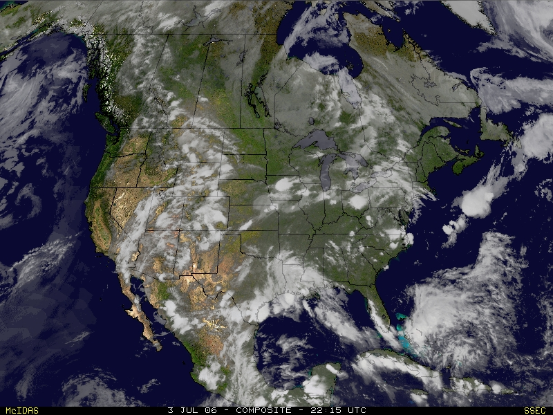
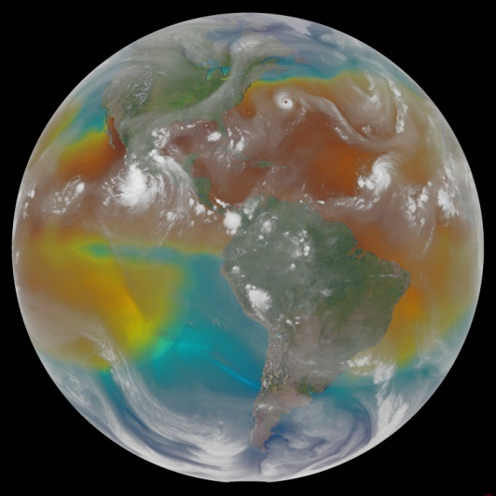
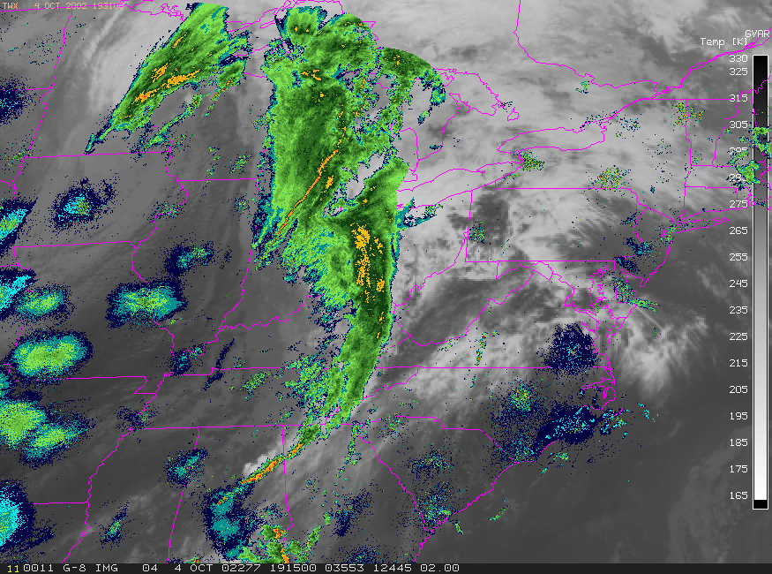
Man-computer Interactive Data Access System for UniX
McIDAS-X

Slide 13
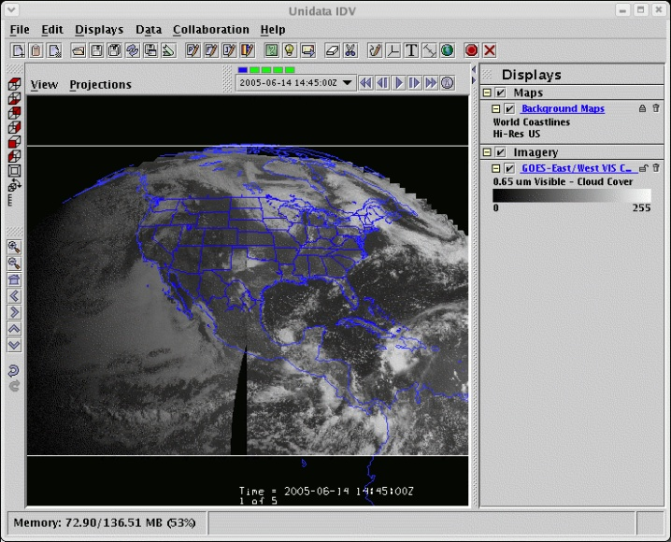
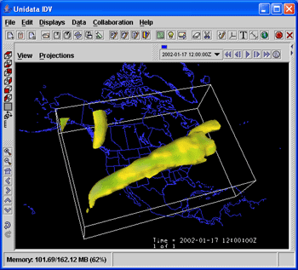
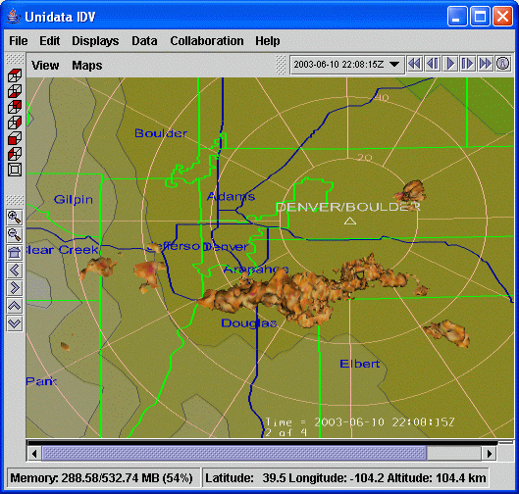
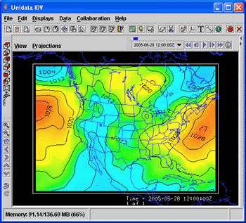
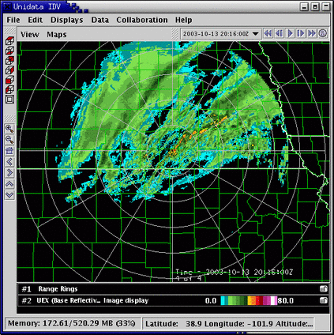
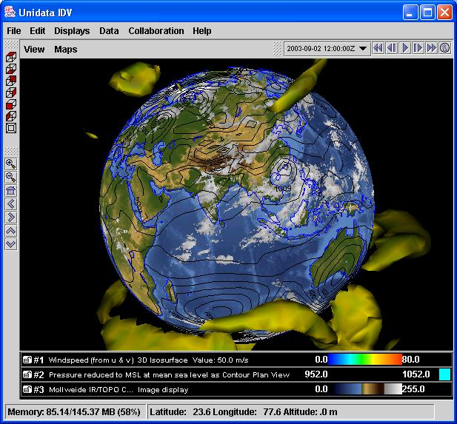
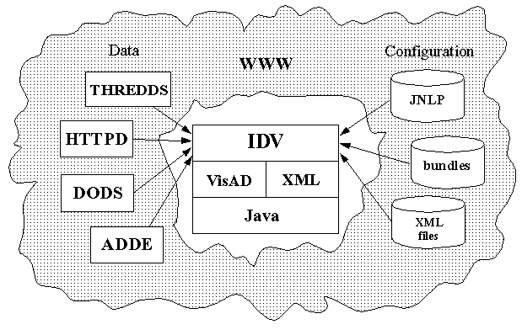
Integrated Data Viewer
IDV
Unidata’s newest scientific analysis and visualization tool
Freely available 100% Java framework and reference application
Provides 2-, 3- and 4-D displays of geoscience data
Stand-alone or networked application integrates data from multiple sources

Slide 14
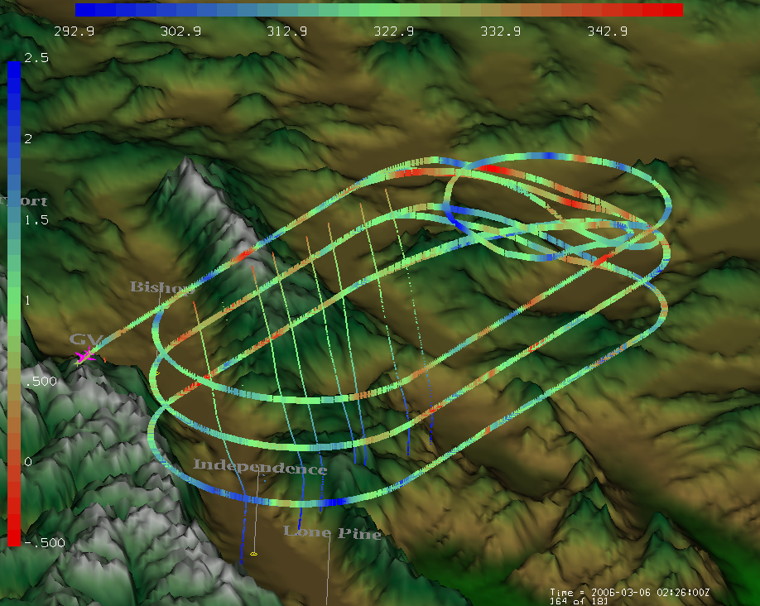
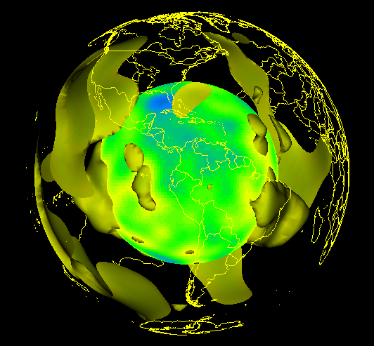
Some IDV Features
Client-server data access from remote systems
Data probes for interactive exploration (slice and dice)
Animations (temporal and spatial)
HTML interface for pedagogic materials
Easy collaboration with other educators
Extensible via Java-based plug-in architecture: for example, geosciences network (GEON) solid earth community

Slide 15
Thematic Real-time Environmental Distributed Data Services (THREDDS)
THREDDS implements data catalogs that allow providers to present data to users and applications
Catalogs are XML metadata describing and pointing to datasets accessible via client/server protocols (OPeNDAP, ADDE, WCS, HTTP)
Discovery centers (master directories, digital libraries, data portals) can find datasets via THREDDS catalogs
Unidata coordinates THREDDS activities, and collaborates with data providers, tool builders, and interoperability experts from academia, government, and industry to implement servers

Slide 16
Other Unidata Products
netCDF Unidata Common Data Model netCDF Java THREDDS | Udunits IDV GEMPAK McIDAS RAMADDA

Slide 17
Opportunities for Collaboration
Universities always eager to get involved with new data
Why N-Wave?
Community question about “New Nwave Network to Support 80 Terabytes of Climate Research per day” July 13, 2010
Can universities get involved and get access to the data, models…..?
Notes:
Research and Education – new data sets are always of interest. They like to bring a new perspective to their students.
New data promotes new ideas for research and education.
Planning ahead is imperative.

Slide 18
Additional Information
Unidata: http://www.unidata.ucar.edu/
Support: support@unidata.ucar.edu

