Slide 1

CONDUIT Update Cooperative Opportunity for NCEP Data using IDD Technology
Rebecca Cosgrove
NCEP/NCO/Production Management Branch
April 11, 2011
Notes:
1

Slide 2
Agenda
Additional Data on CONDUIT
Upcoming NAM upgrade
Future changes
Discussion

Slide 3


Seeking User Input
Since last Usercomm meeting, developed detailed list of possible additions
Unidata posted list to community February 11th asking for requests and input
Response has been underwhelming
We ask that the Usercomm recommend some
additions on behalf of the community

Slide 4
Available Data
HIRESW 5km output nests (ARW and NMM cores)
Alaska, East/Central US, West/Central US, Hawaii, Puerto Rico, Guam
Real-time Ocean Forecast System (RTOFS) – nowcast & forecast
Hybrid curvilinear coordinate system – Atlantic & regional grids
Interpolated to standard lat/lon grid – Atlantic & regional grids
Hurricane model output
HWRF and GFDL model output when storms are run; 1, 1/6th, 1/12th degree nests
NOAA WW3 output
Hurricane wave model, multi-grid wave model, global wave ensemble
Global and regional domains
Climate Forecast System (CFS) version 2 products
North American Ensemble Forecast System (NAEFS)
Ensemble products
RTMA
Alaska 3km – all other grids (incl CONUS 2.5km) available on NOAAPORT

Slide 5
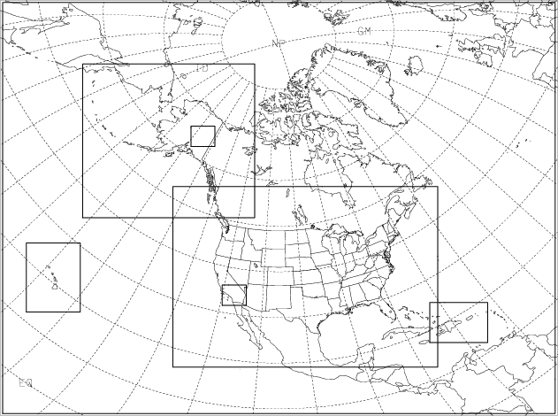
Upcoming NAM Changes
Summer 2011 NAM will be upgraded
New products include Fire Weather and NAM nest products
Fire Weather grid will be 1.33km CONUS grid or 1.5km Alaska grid (0-36 hrs) run over that day’s area of interest for the fire weather community
NAM nests (0-60h)
4km CONUS
6km Alaska
3km Hawaii
3km Puerto Rico
There is interest in using CONDUIT to distribute the Fire Weather grids, if not the NAM nests

Slide 6
Other Changes
Rapid Refresh replaces RUC in Summer/Fall 2011
Includes new larger-domain 32 km grid
CONDUIT tech refresh Fall 2011 or 2012
Increase size of LDM queue to accommodate more products
Timing of refresh determined by demand for additional products
Next GFS upgrade, including possible addition of 0.25 degree grids not till Q2 of FY2012 at the soonest
Dependent on compute resources

Slide 7
Questions/Discussion

