Slide 1
Interoperable Documentation
Ted Habermann, NOAA/NESDIS/NGDC
NCAR Earth Observing Laboratory, June 2010
Links:
GEO-IDE Wiki: https://www.nosc.noaa.gov/dmc/swg/wiki/index.php
ISO WAF: http://www.ngdc.noaa.gov/metadata/published/19115/isoMetadataHome.html
THREDDS Extractor: http://www.ngdc.noaa.gov/eds/tds/oceanSITESMetadataAssessment.html
Spirals: https://www.nosc.noaa.gov/dmc/swg/wiki/index.php?title=Creating_Good_Documentation
Questions During Seminar: jweber@unidata.ucar.edu
Questions / Comments / Suggestions: ted.habermann@noaa.gov

Slide 2
Data Life-Cycle
Question
Data
Collection
Processing
Distribution
Repurposing
Principal Investigator
Documentation Life Cycle:
OAIS Mandatory Archive Responsibility: Ensure that the information to be preserved is Independently Understandable to the Designated Community. In other words, the community should be able to understand the information without needing the assistance of the experts who produced the information.
Archive
Discovery
Analysis
Someone Else

Slide 3
Metadata Types and Sharing
User
Discovery Portal
User
Community Metadata Collections
Discovery
Use / Mashup
Understanding
More documentation is required for understanding data than discovering or using it.

Slide 4
Designated Communities - Users
Question
Data
Collection
Processing
Distribution
Repurposing
Principal Investigator
Documentation Life Cycle:
OAIS Mandatory Archive Responsibility: Ensure that the information to be preserved is Independently Understandable to the Designated Community. In other words, the community should be able to understand the information without needing the assistance of the experts who produced the information.
Archive
Discovery
Analysis
Someone Else

Slide 5
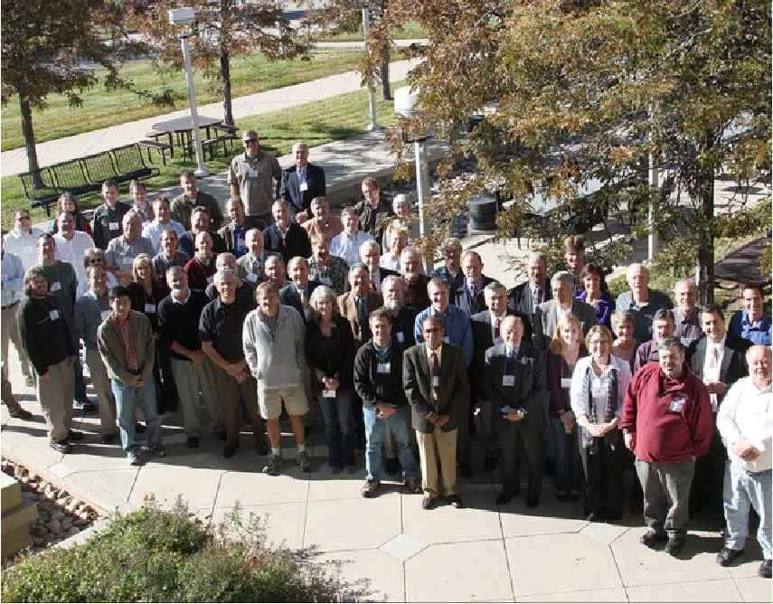

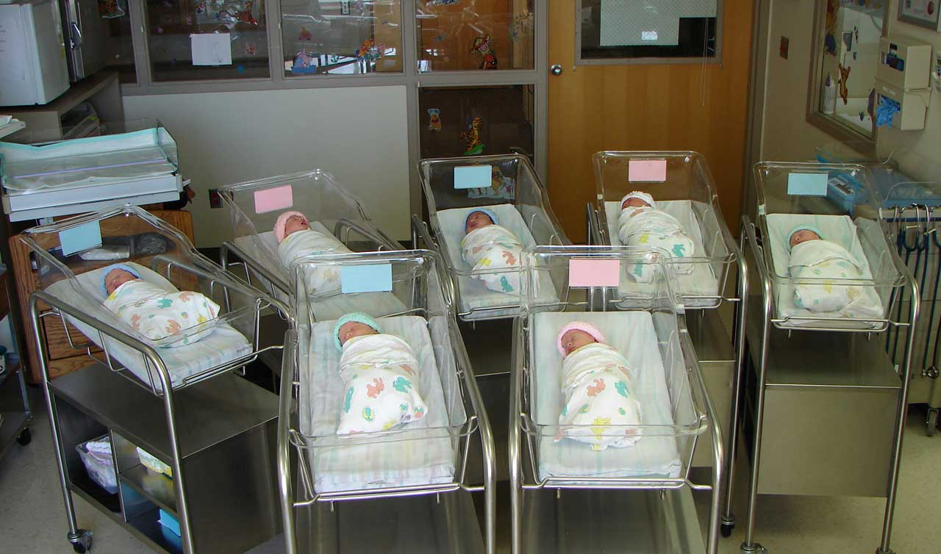
Designated Communities - Users
Data preservation is communicating with the future

Slide 6
Designated Communities - Users
# Users
S
T
A
N
D
A
R
D
S
?
Experts
Non-Experts
Question
Data
Collection
Processing
Distribution
Archive
Discovery
Analysis

Slide 7
Interoperable Documentation
Data
Information
Knowledge
Wisdom
Many concepts have been well developed and successfully implemented to achieve (or at least improve) data interoperability
Can the same concepts facilitate interoperable information?
Data to Information Concept Mapping:
Evolution
Variables and Properties
Multiple Dialects
Persistence vs. Transport
Hierarchical Organizations
Standards and Conventions
Spiral Development
Spatial/Temporal Data
Training
The Continuum of Understanding, Nathan Shedroff

Slide 8
Evolution: Data
O&M 1.0
O&M 1.0
O&M 2.0
WXXM 1.0
WXXM 1.1
WXXM 2.X
Aligned with
WXXM Builds
on CSML 3.X
(XML encoding)
O&M 2.0
CSML 1.0
CSML 2.X
CSML 3.X
Aligned with
Aligned with
Unidata CDM
Unidata CDM
Unidata CDM
(Binary encoding)

Slide 9
Evolution: Documentation Standards
Basic Content
Extended Content
FGDC Complete
Entity and Attribute
Data Quality
Lineage
Spatial Organization
Spatial Reference
FGDC RSE
Identifier
Documentation
Mission
Platform
Instrument
Aggregation
Algorithm
Processing
FGDC Mandatory
Identification
Metadata
Custom
Documentation
FGDC Discovery
Distributor
FGDC to ISO 19115
International Standard
Unified Modeling Language
ISO 19115
Code Lists
Many Identifiers
OnLine Resources
Responsible Parties
Data Quality Reports
Spatial/Temporal Extents
Metadata Levels / Scope
ISO 19119
Services
ISO 19110
Feature
Types
ISO 19115-2
Quality Coverage
Usability
Platform
Instrument
Processing
Algorithm
Notes:
Animated version

Slide 10
Variables and Properties - Data
<variable name="MHchla" type="float" shape="time altitude lat lon">
<attribute name="_CoordinateAxes" value="time altitude lat lon "/>
<attribute name="_FillValue" value="-9999999.0 " type="float"/>
<attribute name="actual_range" value="0.01 63.997 " type="float"/>
<attribute name="coordsys" value="geographic"/>
<attribute name="fraction_digits" value="2 " type="int"/>
<attribute name="long_name" value="Chlorophyll-a, Aqua MODIS, NPP, 0.05
degrees, Global, Science Quality"/>
<attribute name="missing_value" value="-9999999.0 " type="float"/>
<attribute name="numberOfObservations" value="9664503 " type="int"/>
<attribute name="percentCoverage" value="0.2589298000257202 "
type="double"/>
<attribute name="standard_name"
value="concentration_of_chlorophyll_in_sea_water"/>
<attribute name="units" value="mg m-3"/>
</variable>

Slide 11
Variables and Properties - Documentation
MD_Metadata
+contentInfo 0..*
MD_CoverageDescription
+ attributeDescription : RecordType
+ contentType [1.*]: MD_CoverageContentTypeCode
+ processingLevelCode [0..1]: MD_Identifier
+dimension 0..*
MD_RangeDimension
+ sequenceIdentifier [0..1] : MemberName
+ name[0..*]: MD_Identifier
+ description [0..1] : CharacterString
+rangeElementDescription 0..*
MD_SampleDimension
MI_RangeElementDescription
+ minValue [0..1] : Real
+ maxValue [0..1] : Real
+ units [0..1] : UnitOfMeasure
+ scaleFactor [0..1] : Real
+ offset [0..1] : Real
+ numberOfValues [0..1] : Integer
+ meanValue [0..1] : Real
+ standardDeviation [0..1] : Real
+ otherAttributeType [0..1] : RecordType
+ otherAttribute [0..1] : Record
+rangeElementDescription
0..*
+ name : CharacterString
+ definition : CharacterString
+ rangeElement[1..*] : Record
<<CodeList>>
MD_CoverageContentTypeCode
+ image
+ thematicClassification
+ physicalMeasurement
+ referenceInformation
+ qualityInformation
+ auxilliaryData
+ modelResult
minValue, maxValue and units must have units of length.
RangeElement, otherAttributeType, and other Attribute have cardinality [0..0]
MD_Band
+ peakResponse [0..1] : Real
+ bitsPerValue [0..1] : Integer
+ toneGradation [0..1] : Integer
Community Input to Revisions

Slide 12
Documentation in Multiple Dialects
ISO
DIF, FGDC,
Data.Gov
Documentation
Repository
ISO 19115, 19115-2, 19119 and extensions
netCDF
SensorML
THREDDS
WCS, WMS, WFS, SOS
KML

Slide 13
Persistence vs. Transport - OPeNDAP
File System
File System
DAP
DAP
Client

Slide 14
Persistence vs. Transport - Documentation
Relational Databases
File System
Rich Inventory
XML
XML
Client

Slide 15
Hierarchical Organization: Data
File
+has
1..*
+ readme
+ parentDirectory 0..*
Directory
+ subdirectory
0..*
Platform
Sensor
Sensor

Slide 16
Hierarchical Organization: Documentation
MI_Metadata
(from Metadata entity set information)
+has
1..*
+ seriesMetadata
1..*
+ superset 0..*
DS_DataSet
Multiple
Aggregation
DS_Series
+ composedOf
1..*
+ subset 0..*
DS_Platform
DS_Sensor

Slide 17
Hierarchical Organization: InSitu Documentation
Program Documentation
Office of Climate Observations
Other Projects
Other Networks
AggInfo
LWCit
AggInfo
CRef
Project Documentation
AggInfo
LWCit
AggInfo
CRef
<<CodeList>>
MX_ScopeCode
Network Documentation
MI – Network
Extent
Distribution
AggInfo
LWCit
+ attribute + feature
+ attributeType + featureType
+ collectionHardware + propertyType
+ collectionSession + fieldSession
+ dataset + software
+ series + service
+ nonGeographicDataset + model
+ dimensionGroup + tile
+ productionSeries + initiative
+ sensorSeries + sensor
+ platformSeries + otherAggregate
+ transferAggregate + stereoMate
Platform Documentation
DS_Platform
seriesMetadata
MI – Platform
subset
DS_Sensor
DS_DataSet
MI – Deployment 1
MI – Deployment 2
MI – Deployment 3
seriesMetadata
MI - Sensor
Other Deployments
AggInfo
CRef
THREDDS Data Server
netCDF files
Other formats
Deployment Documentation
MI – Deployment
AggInfo
CRef
NcML
XSLT
ISO
Other Platforms
Notes:
17

Slide 18
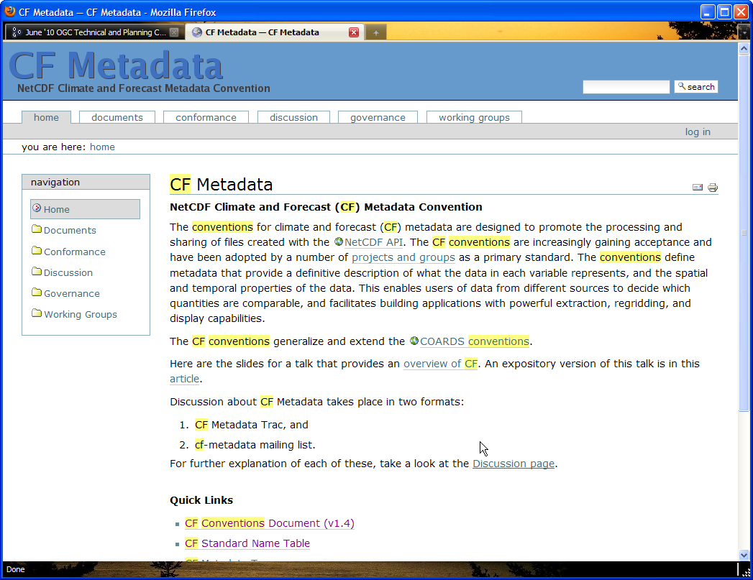
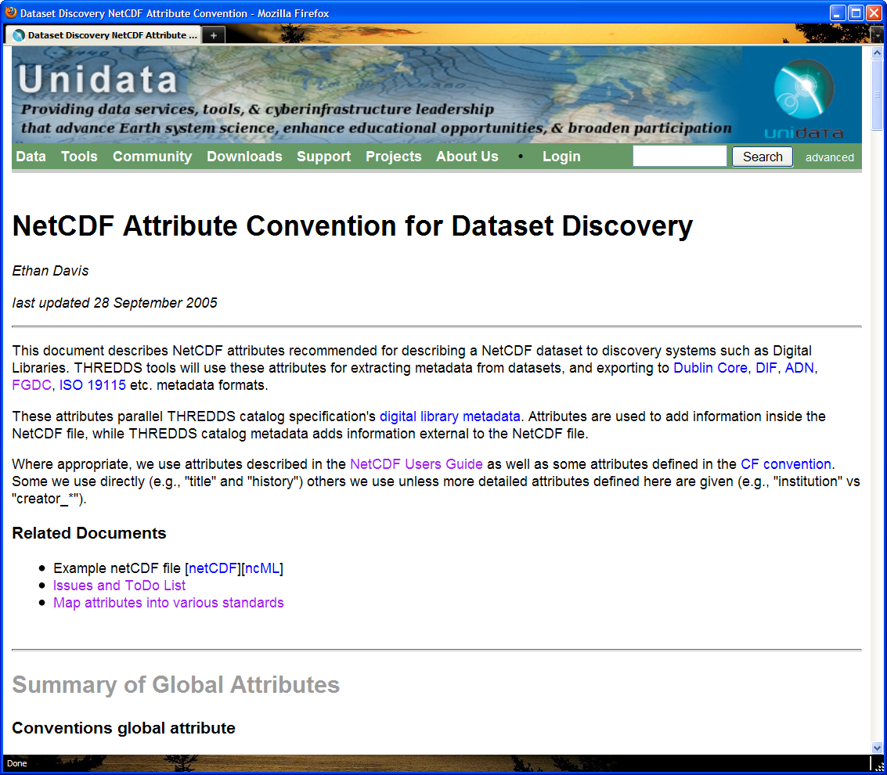
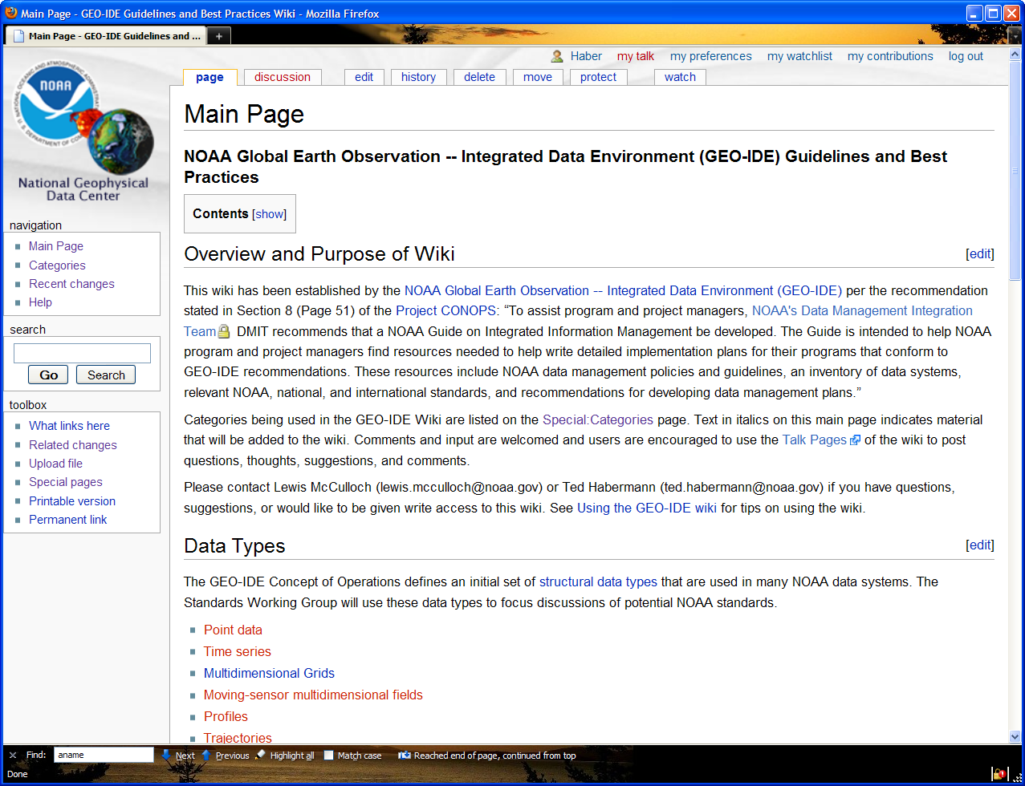
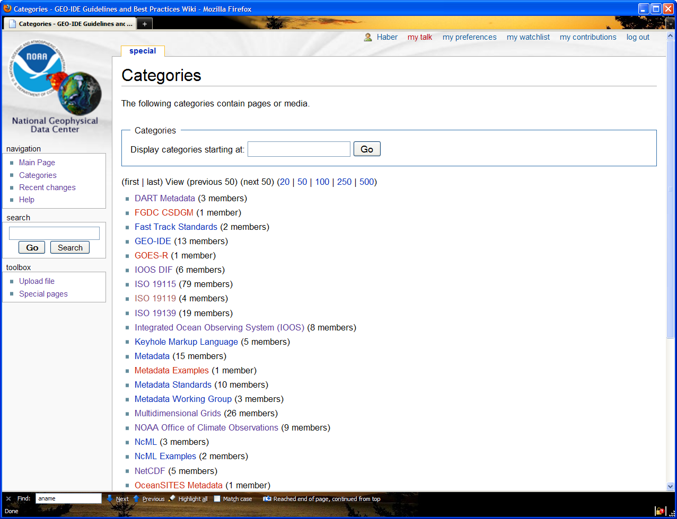
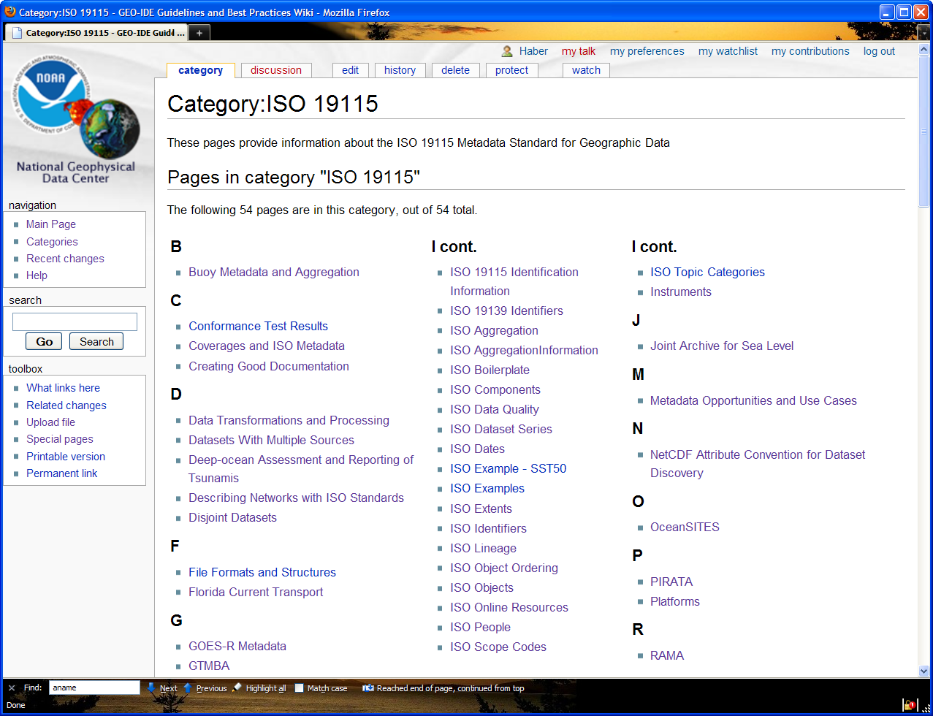
Standards / Conventions / Best Practices
A Security exception is required to view this page because we have a self-signed certificate.
It is safe!

Slide 19
Spatial/Temporal Data
<<DataType>>
EX_Extent
+description [0..1]: Character String
+geographicElement
[0..*]
+temporalElement
[0..*]
+verticalElement
[0..*]
<<Abstract>>
EX_GeographicExtent
EX_TemporalExtent
EX_VerticalExtent
+extent: TM_Primitive
+minimumValue: Real
+maximumValue: Real
+unitOfMeasure: UomLength
+extentTypeCode [0..1]: Boolean="1"
EX_BoundingPolygon
EX_GeographicBoundingBox
EX_GeographicDescription
+polygon [0..1]: GM_Object
+westBoundingLongitude: Decimal
+eastBoundingLongitude: Decimal
+southBoundingLatiitude: Decimal
+northBoundingLatiitude: Decimal
+geographicIdentifier: MD_Identifier
Ex_Extents can be used to describe datasets, sources, and quality reports.

Slide 20
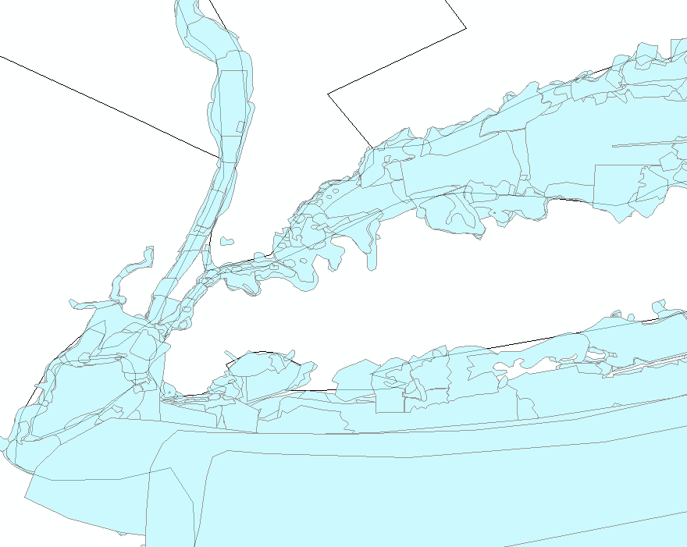
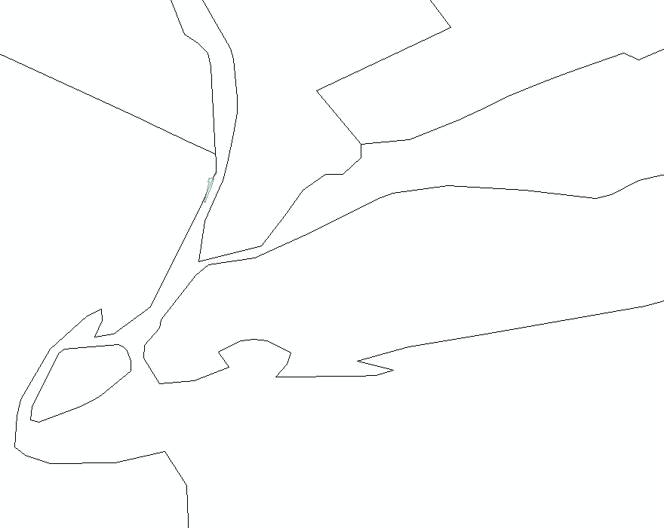
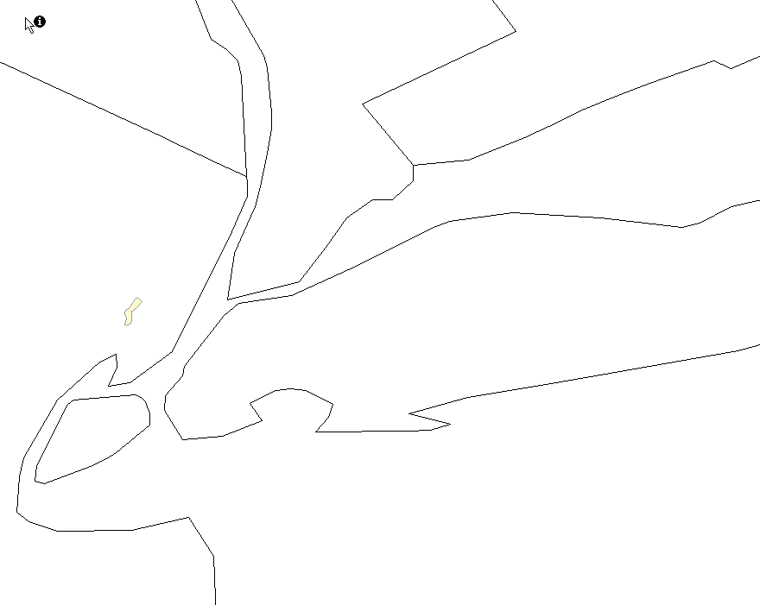
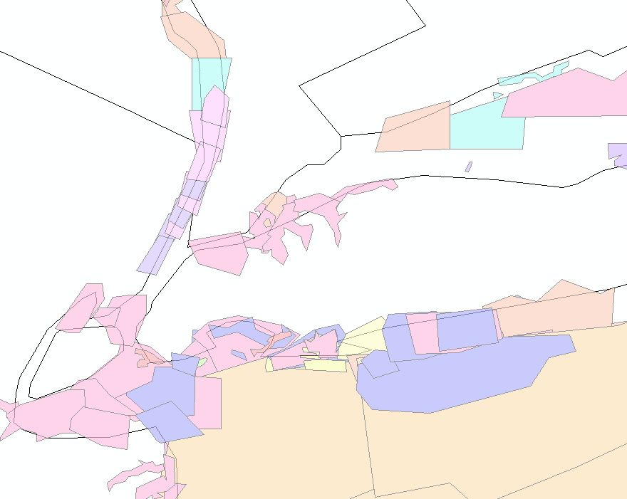
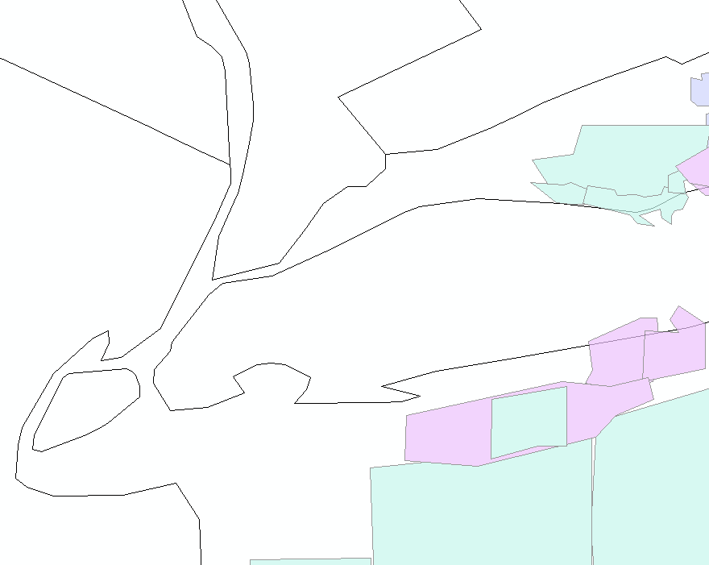
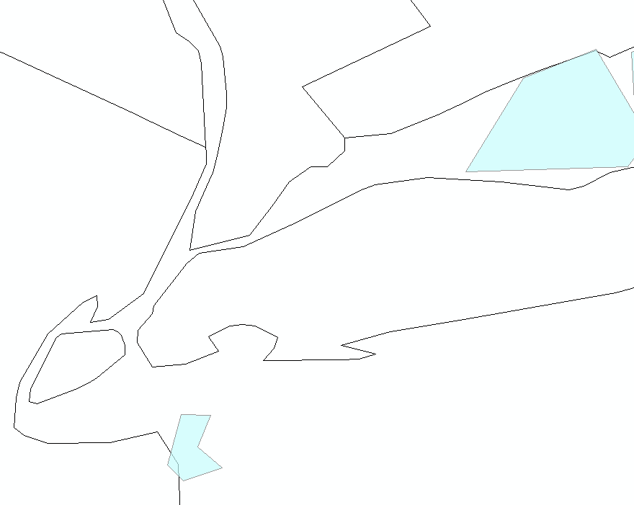
Spatial/Temporal Data
The National Ocean Service Hydrographic Survey dataset includes many sources collected at different locations and times. These extents can be described clearly using the ISO objects discussed in this presentation.
New Jersey
Long Island
The metadata evolves from a single extent to a complete spatial / temporal dataset.
1900-1925
1926-1950
1951-1975
1976-2000
2001-2007

Slide 21
Multiple Dialects Revisited
ISO
DIF, FGDC,
Data.Gov
Documentation
Repository
ISO 19115, 19115-2, 19119 and extensions
netCDF
SensorML
THREDDS
WCS, WMS, WFS, SOS
KML

Slide 22
Multiple Dialects: THREDDS Data Server
OPeNDAP
WMS
WCS
Extract Data
THREDDS
Catalog
THREDDS
Catalog
THREDDS
Catalog
file1.nc
file2.nc
file3.nc
file4.nc
file1.nc
file2.nc
file.nc
file.nc
file.nc
file.nc

Slide 23
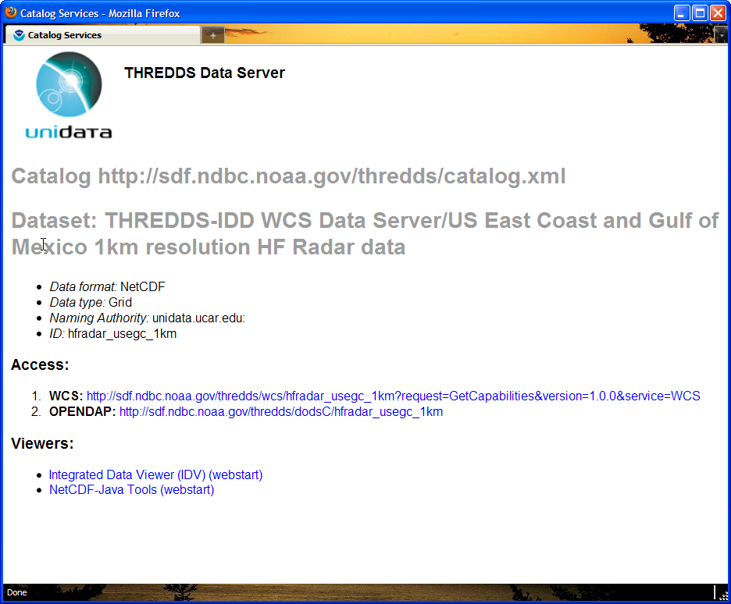
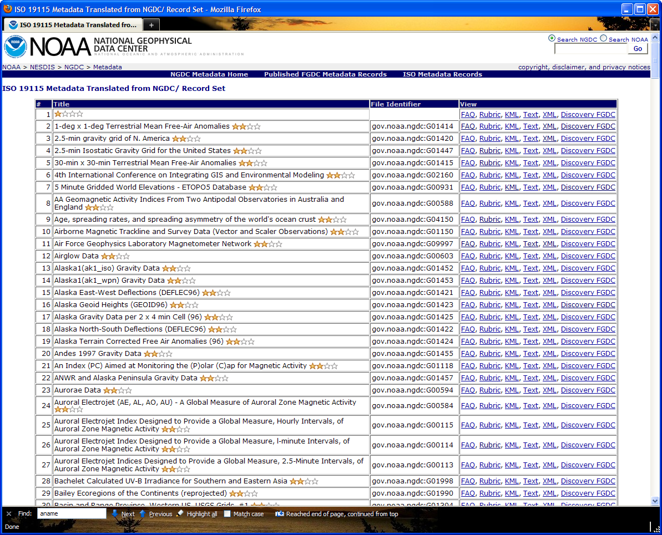
Multiple Dialects: Web Accessible Folders

Slide 24
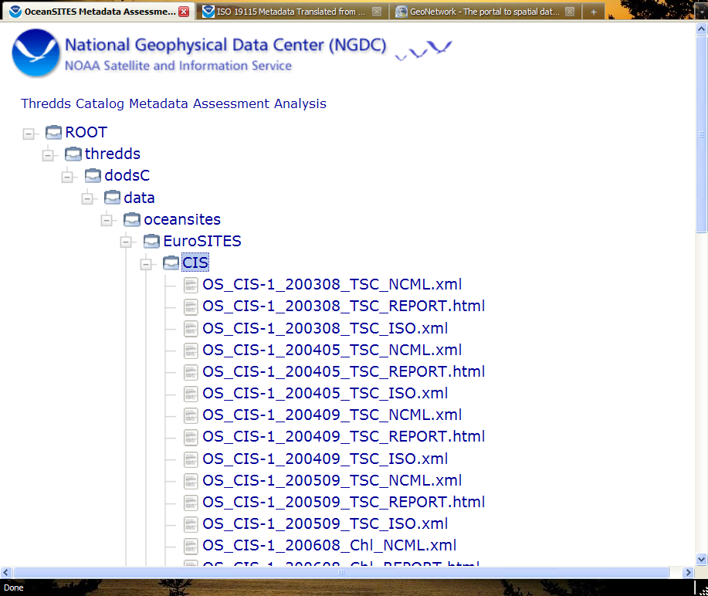
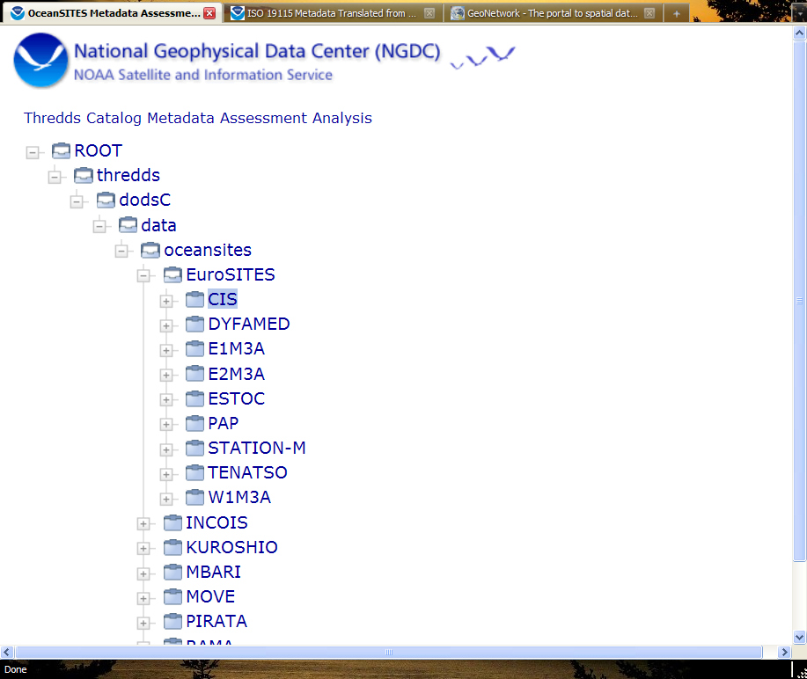
Multiple Dialects: Documentation Extraction
NcML
HTML
Spiral Tracker
Documentation
Repository
ISO XML
THREDDS
Catalogs
file.nc
file.nc
file.nc
file.nc
Notes:
OceanSITES documentation exists in netCDF files that are accessible through THREDDS Catalogs. What can we do with that documentation?
We have a THREDDS Catalog Crawler that identifies files (or datasets) in catalogs and extracts the NcML from those files. That NcML is then translated using standard XML tools (XSLT) into:
1) A rubric that examines the NcML for fields that are recommended by the Unidata Data Discovery

Slide 25
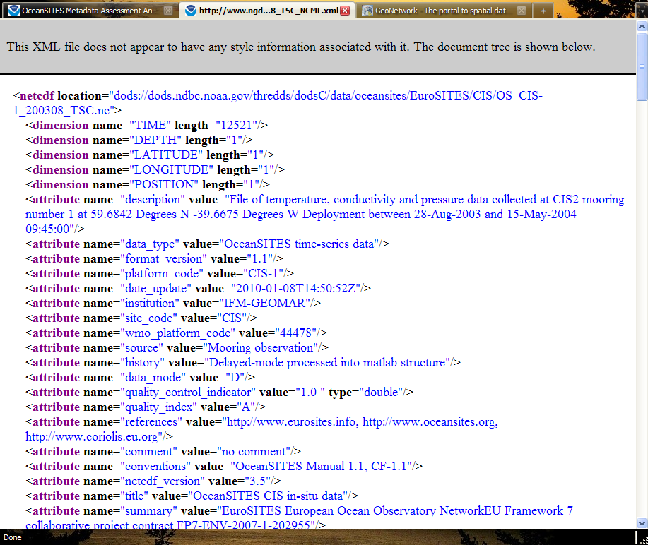
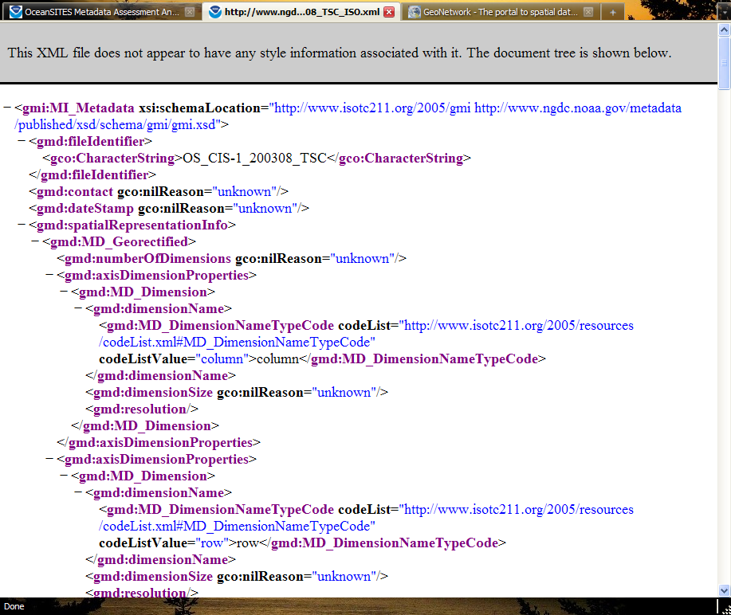
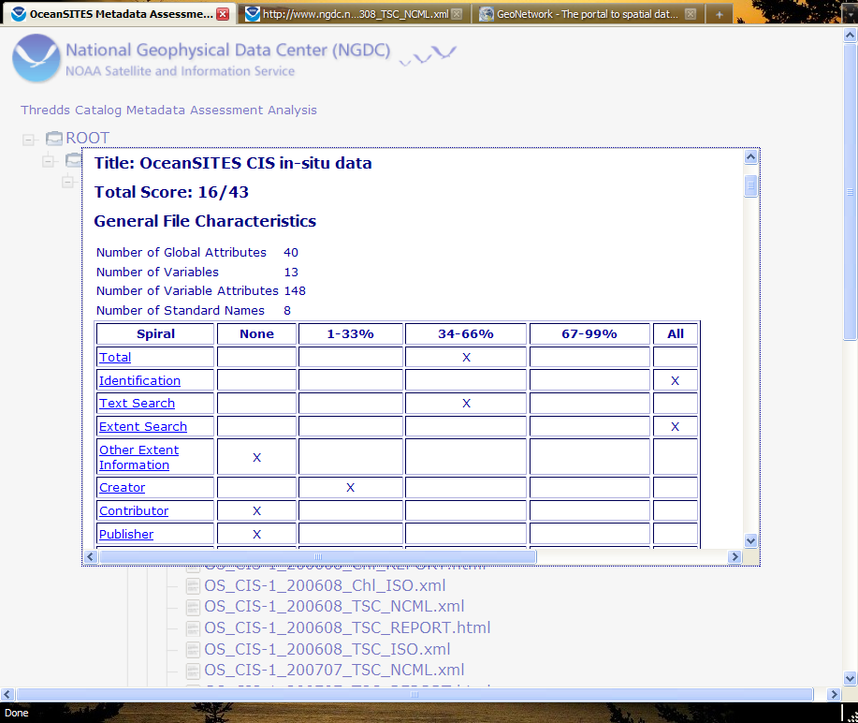
Documentation in Three Dialects
NcML
Documentation
Repository
Spiral Tracker

Slide 26
Spiral Development / Training
Check Back
With Data Collectors/
Providers
Check Back
With Users
Standard
Guidance / Implementation
Spiral 2-N:
Scientific Questions
New Requirements
New Use Cases
Metadata Content
Independent of standard
Spiral 1:
Initial Content

Slide 27
Spiral Development / Training: Potential Spirals
Discovery
Understanding
Identification
Id
Title
Abstract
Resource Date
Topic Category
Theme Keyword
Metadata Contact
Science Contact
Extent
Geospatial Bounding Box
Temporal Start/End
Vertical Min/Max
Place Keywords
Acquisition Information
Instrument
Platform
Instrument Keywords
Platform Keywords
Content Information
Attribute Type
Attribute Names
Attribute Definitions
Attribute Units
Connection
OnlineResource:
Name
Description
Function
Application Schema
Distribution
Distributor Contact
Online Resource
Distribution Format
Data Center Keywords
Browse Graphic
Text Searches
Purpose
Extent Description
Lineage Statement
Project Keywords
Quality/Lineage
Sources
Process Steps
Quality Reports / Coverages

Slide 28
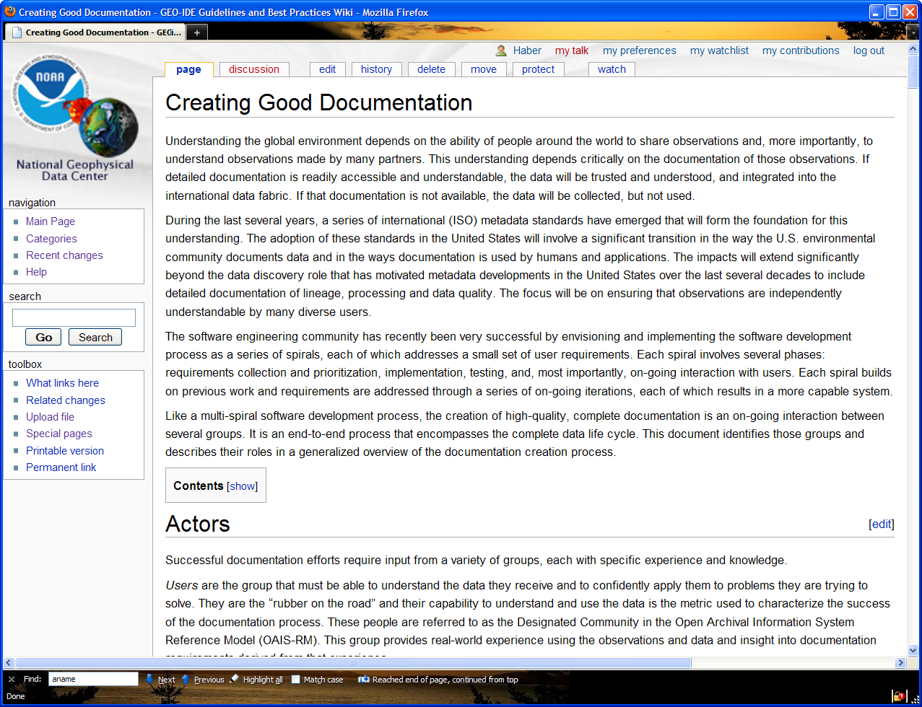
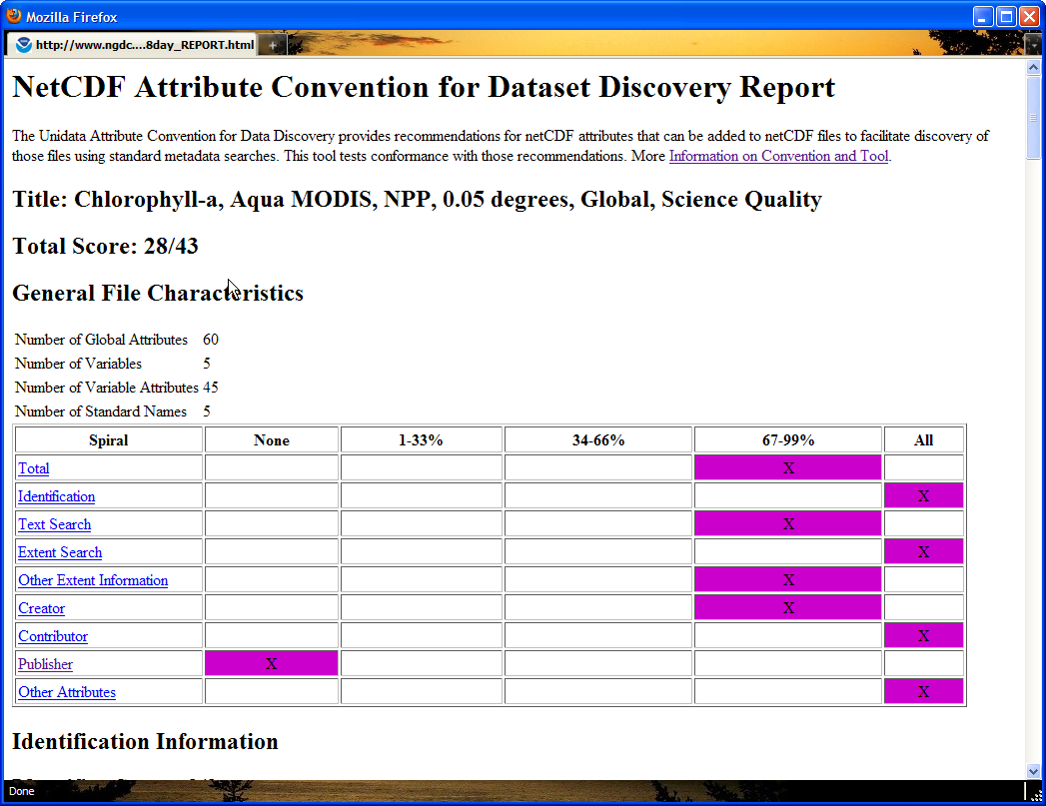
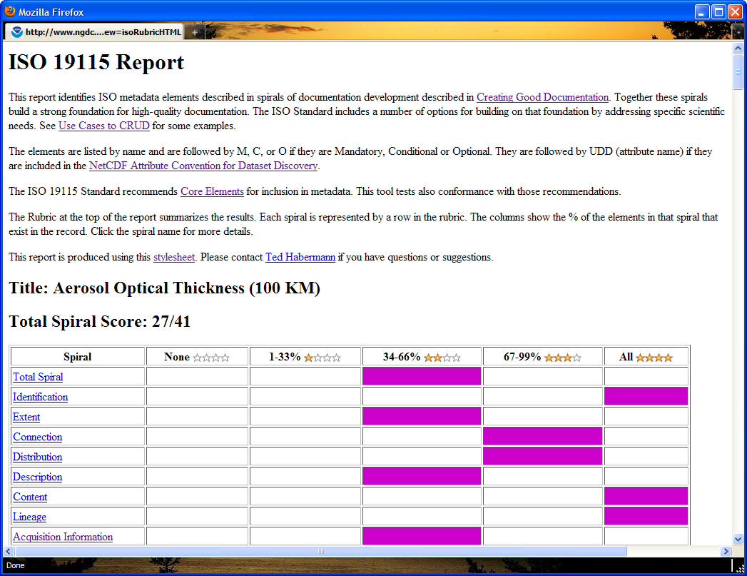
Spiral Development / Training: Rubrics

Slide 29
Data and Information: End-to-End Process
Producers
Consumers
Community
Data
Information
Knowledge
Wisdom
Data to Information Concept Mapping
Variables and Properties
Multiple Dialects
Persistence vs. Transport
Standards and Conventions
Spiral Development
Spatial/Temporal Data Systems
Hierarchical Organizations
Training
Evolution

Slide 30
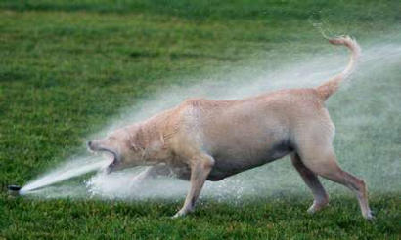
Questions?

